Slide 1


Quickstart
※”IT Automation” will be written as “ITA” in this document
Exastro IT Automation Version 1.7.2
Exastro developer

Slide 2
Table of contents
Introduction
1.1 Introduction
1.2 Scenario overview
1.3 Terminology
Screen Description
2.1 Web console screen description (Login)
2.2 Screen Description (Main Menu)
2.3 Screen Description (Menu)
Preparation
3.1 Uploading Playbook and Linking it to a job (Movement)
3.2 Implementing job (Movement) into Jobflow (Conductor)
3.3 Configure CMDB Data sheet and Parameter sheet
3.4 Register Data to Datasheet
3.5 Link Parameter sheet item to Playbook variable
Execution(First time)
4.1 Register target (Linux machine) to Device list
4.2 Register Operation name (Operation)
4.3 Register data to Parameter sheet
4.4 Execute Jobflow (Conductor)
4.5 Check Execution results

Slide 3
Table of Contents
５．Execution (Second time)
5.1 Register Operation name (Operation)
5.2 Register data to Parameter sheet
5.3 Execute Jobflow (Conductor)
5.4 Check Execution results
６． Checking the CMDB Parameter history
6.1 Executing operations and History Management
6.2 Checking the CMDB Parameter history
A Appendix
Reference① 【Ansible-Legacy】Single Execution
Reference② 【Ansible-Legacy】Execution check

Slide 4
1. Introduction

Slide 5


1.1 Introduction (1/2)
This document serves as a quick start guide for users who are using IT Automation (written as ITA) for the first time.
By installing Linux server packages, we can automate and centralize and automate package management for each server. That way, we can use ITA and have a more efficient system than we could achieve from a conventional system.
Normal System
construction
ITA Automated System construction
New procedures for every construction/operation
Uses procedures that can be reused
(Playbook)
Separately managed parameter sheets
Centrally/history managed parameter sheets
Manual system construction
Automated system construction

Slide 6
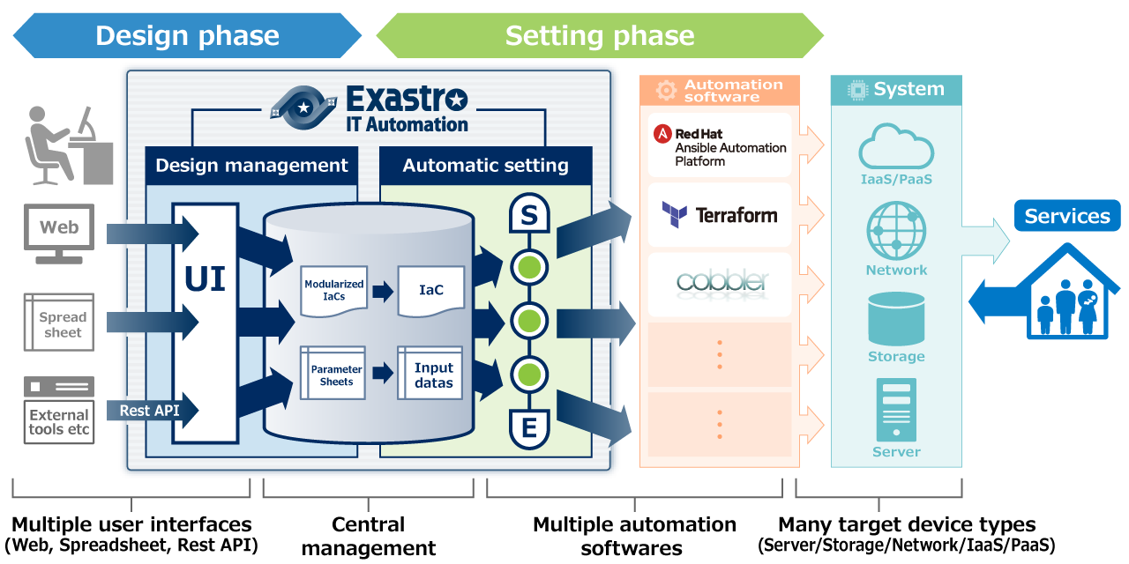
1.1 Introduction (2/2)
Main ITA functions used in this document.
・ Linking with Automation software (Ansible).
・ Parameter management (Creation, Registration and history management of Menus)
・ Linking Variables (Automatic registration of substitute values)
Used in this document

Slide 7







1.2 Scenario overview(1/3)
In this scenario, we will use Ansible Driver to manage the parameters for each server and automate the Yum Package installations, which is often used when constructing Linux servers.
Environment
CentOS 7.8
CentOS 7.8
(host A)
Google Chrome
Exastro IT Automation
1.7.2
Packages installed using ITA/Ansible
(※No need to install in advance)
Windows10
Ansible 2.10
Systems used
Exastro IT Automation 1.7.2
CentOS Linux 7.8(for ITA Server)
CentOS Linux 7.8(for Target machine)
Windows 10(Client)
Google Chrome (Win10 side)

Slide 8

1.2 Scenario overview (2/3)
Scenario execution image
CentOS 7.8
Exastro IT Automation 1.7.2
Device list
Operation list
Host name | IP address | ･･･
hostA | xx.xxx.xx.xx | ･･･
Operation | Date
Operation 1 | 〇/〇
Operation 2 | 〇/〇
パラメータシート
サイズ修正中
Select Operation and execute
Host name | Operation | Parameter
 |  | httpd | Mariadb-server | php | perl | python
hostA | Operation 1 | Yes |  | Yes | Yes | Yes
hostA | Operation 2 | Yes | Yes | Yes | Yes | Yes
Job flow (Conductor)
Playbook
S
Ansible
････
･････････
･･･････
･･････
････････
･･･
Data sheet
Variable A
CentOS 7.8 (Host A)
Flag
Yes
E

Slide 9
1.2 Scenario overview(3/3)
Post-installation Ansible Legacy execution scenario.
The figure below illustrates the scenario as well as the Developer(Preparation)/Operator(Execution) operations.
Preparation
Execution
Upload Playbook and link them to jobs(Movement)
Register Linux machine to Device list
★ Repeat ★
Insert job(Movement) into Jobflow (Conductor)
Register Operation name
Configure Data sheet and Parameter sheet to CMDB.
Register data to Parameter sheet.
Register Data to Datasheets
Execute job flow (Conductor)
Link Parameter sheet items and Playbook variables
Check execution results.

Slide 10
1.3 Terminology
The following table explains the different terminology used in this document
Word | Description
Playbook | A file that describes routine tasks that can be executed with Ansible. All Playbook are written in YAML format.
Ansible-Legacy | A function that allows users to use Ansible from ITA. In the Legacy console, this is used when YAML files are used for the building code.
Operation name(Operation) | Operation unit in ITA. Users can set their execution dates in advance, manage the execution history and more.
Conductor | A sequence of work units. It can be executed after an operation name has been linked to it. Combine several parts called Nodes to create a workflow. It can then be used to execute configuration/construction operations on multiple machines.
Movement | Configuration/Construction units used with each of the devices construction tools.
For more information regarding the terminology, please refer to the first step guide.
If you want more information regarding Exastro ITA, please refer to the Document page on the community website.

Slide 11
2. Screen Description

Slide 12
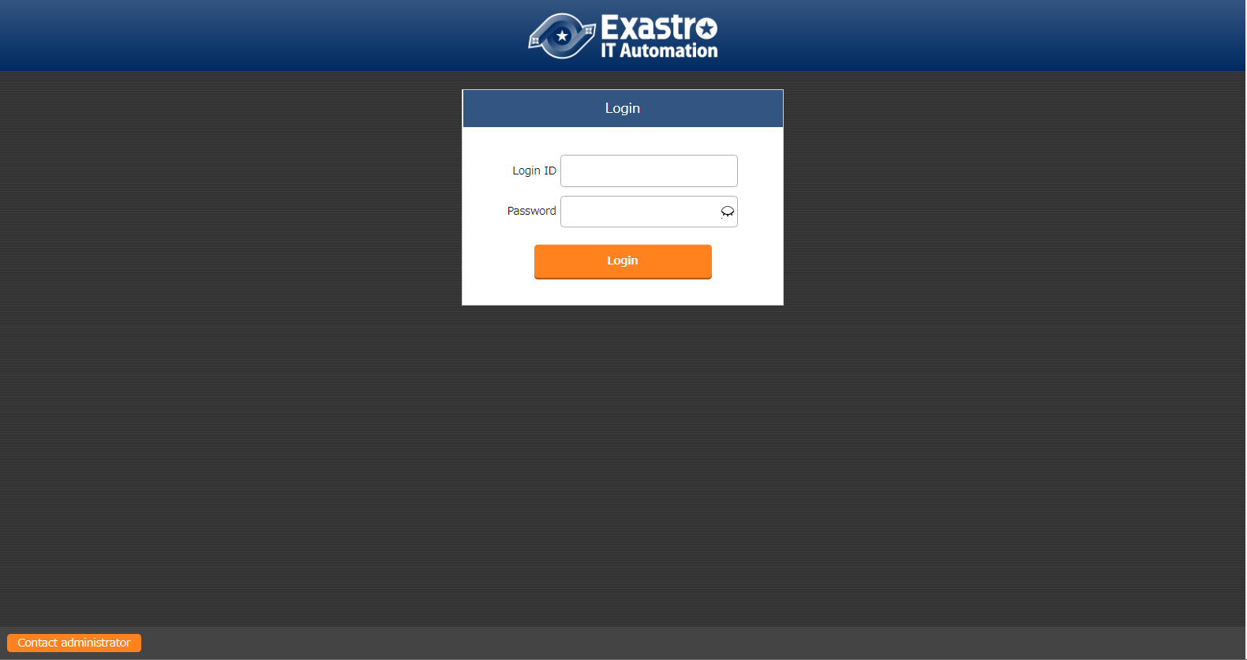
2.1 Web console screen description（Login）
Web Console login screen
Accessing ITA via URL after it has been installed will direct the user to the login screen
※For information regarding how to install ITA, please refer to the Online Install manual
Point
Users logging in for the first time will be ask to change their password

Slide 13
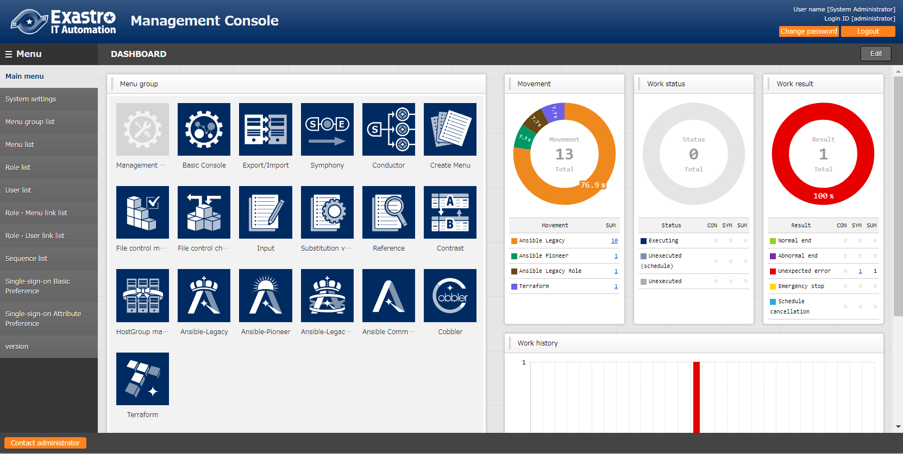
2.2 Screen Description (Main Menu)
Screen description (Main Menu)
The main functions of the Main Menu screen is as following
Point
For more detailed information regarding the different functions, please refer to the manual.
Menu bar
Menu groups

Slide 14
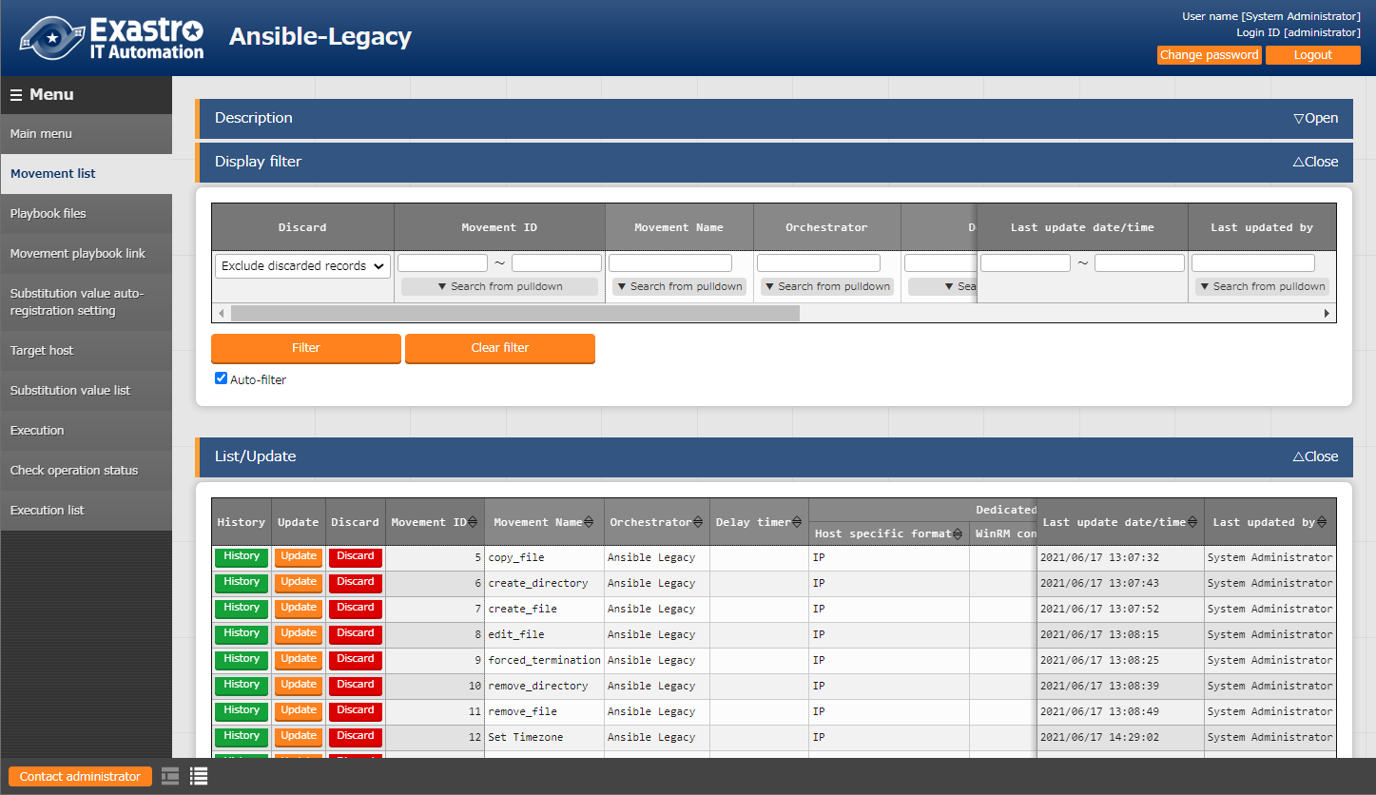
2.3 Screen Description (Menu) (1/2)
Screen Description（Menus）
The name of the basic functions are as following.
Submenu
■Submenu outline
 | Explanation | ：Contains a brief description regarding the menu.
 | Display Filter | ：Lets the user search for registered information
 | List/Update | ：Displays registered information
Point
For more detailed information regarding the different functions, please refer to the manual.

Slide 15
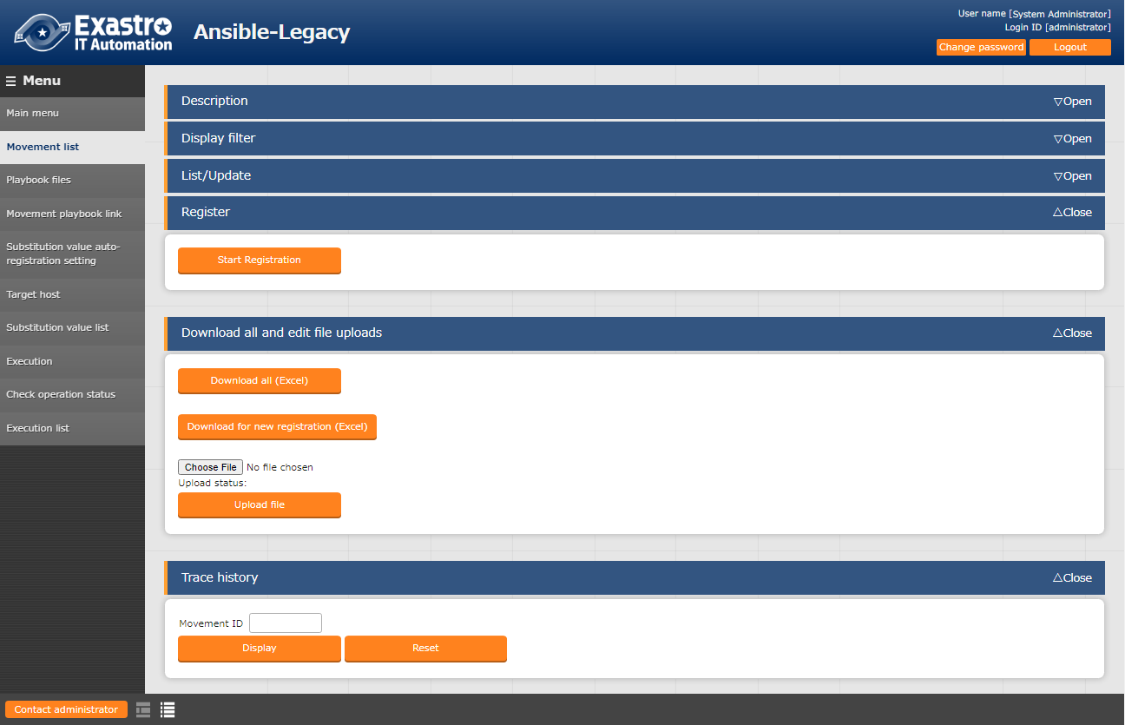
2.3 Screen Description (Menu) (2/2)
Screen description（Menu）
The name of the basic functions are as following
Submenu
■Submenu outline
 | Register | ：Allows the user to register records from the browser
 | Download all and edit file uploads
 |  | ：IN/OUT processing with Excel
 | Change history | ：Change history of registered records
Point
For more detailed information regarding the different functions, please refer to the manual.

Slide 16
3. Preparation

Slide 17
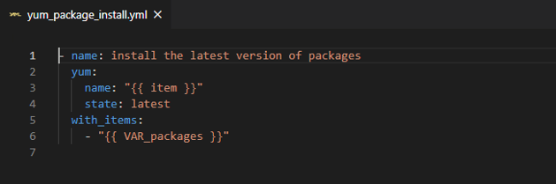
3.1 Uploading Playbook and linking it to a job(Movement) (1/5)
Playbook preparation
First, we need to create the Playbook files that we are going to use.
Use your desired editor program to create the following YML file and save it to your local hard drive.
yum_package_install.yml
Uploading Playbook
and linking it to a job(Movement)
- name: install the latest version of packages
yum:
name: "{{ item }}"
state: latest
with_items:
- "{{ VAR_packages }}"
Implementing job (Movement)
into Jobflow (Conductor)
Configure CMDB Data sheet
and Parameter sheet
Register Data to Datasheet
Point
Make sure that the character code is "UTF-8" and the newline code is "LF".
The file should be saved as an yml file.
Please be check that the indents are correct.
Link Parameter sheet item
to Playbook variable.
Register target (Linux machine)
to Device list.

Slide 18
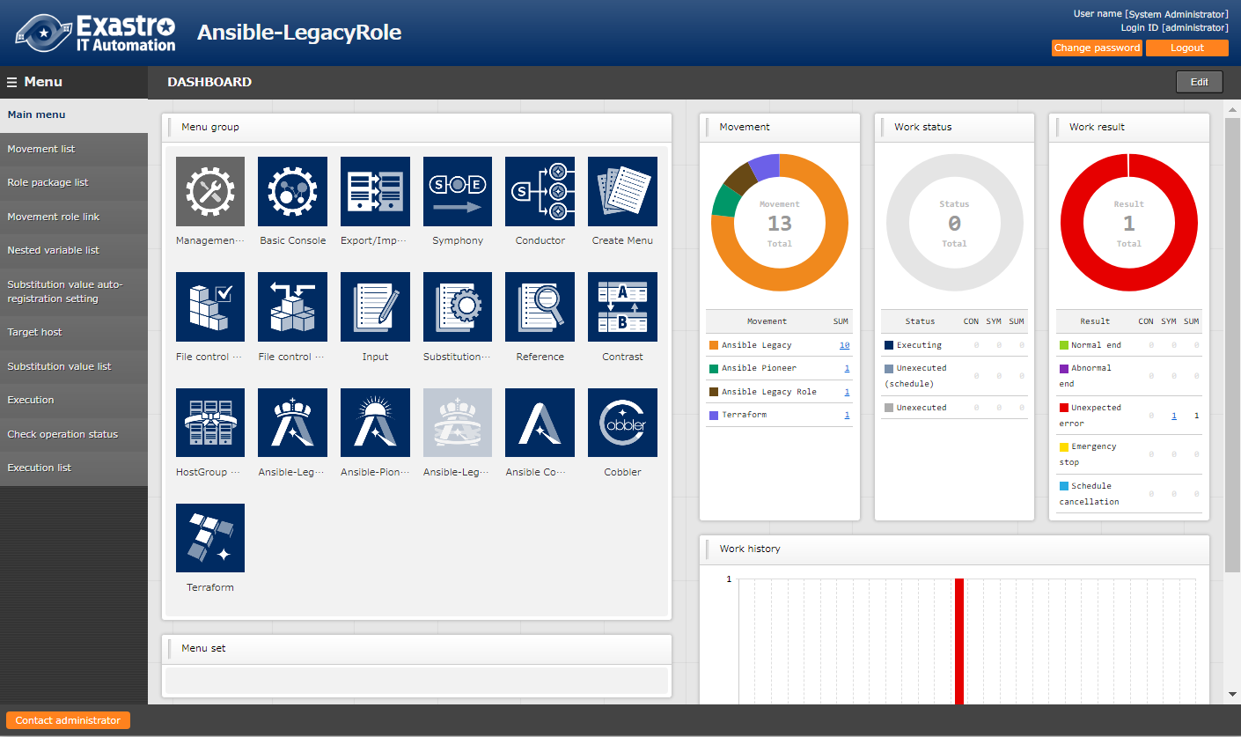
3.1 Uploading Playbook and linking it to a job(Movement) (2/5)
Register Movement to the Movement list.
In the next step, we will register a Movement.
From the main menu , go to the Ansible-LegacyRole menu and then to the Movement list menu.
Uploading Playbook
and linking it to a job(Movement)
Implementing job (Movement)
into Jobflow (Conductor)
2
Configure CMDB Data sheet
and Parameter sheet
Register Data to Datasheet
Link Parameter sheet item
to Playbook variable.
1
Register target (Linux machine)
to Device list.

Slide 19
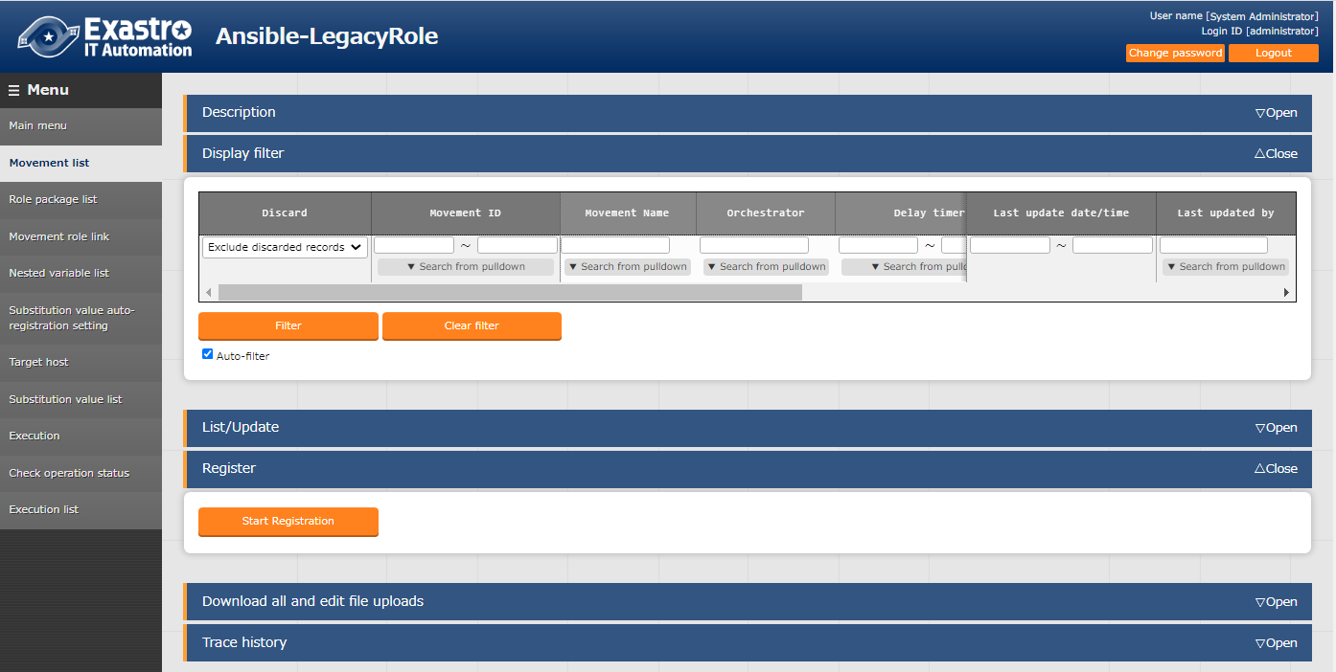
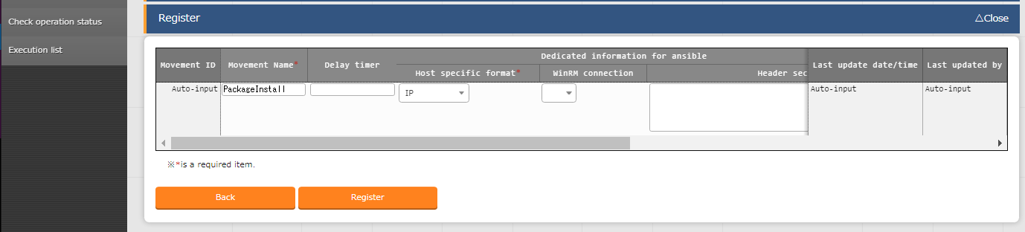
3.1 Uploading Playbook and linking it to a job(Movement) (3/5)
Register Movement to the Movement list.
Click the “Start Registration” button.
Follow the table listed below and fill out the different items before pressing the “Register” button.
Uploading Playbook
and linking it to a job(Movement)
Implementing job (Movement)
into Jobflow (Conductor)
Configure CMDB Data sheet
and Parameter sheet
Register Data to Datasheet
3
Link Parameter sheet item
to Playbook variable.
Register target (Linux machine)
to Device list.
4
Movement name | Host format
PackageInstall | IP
5

Slide 20
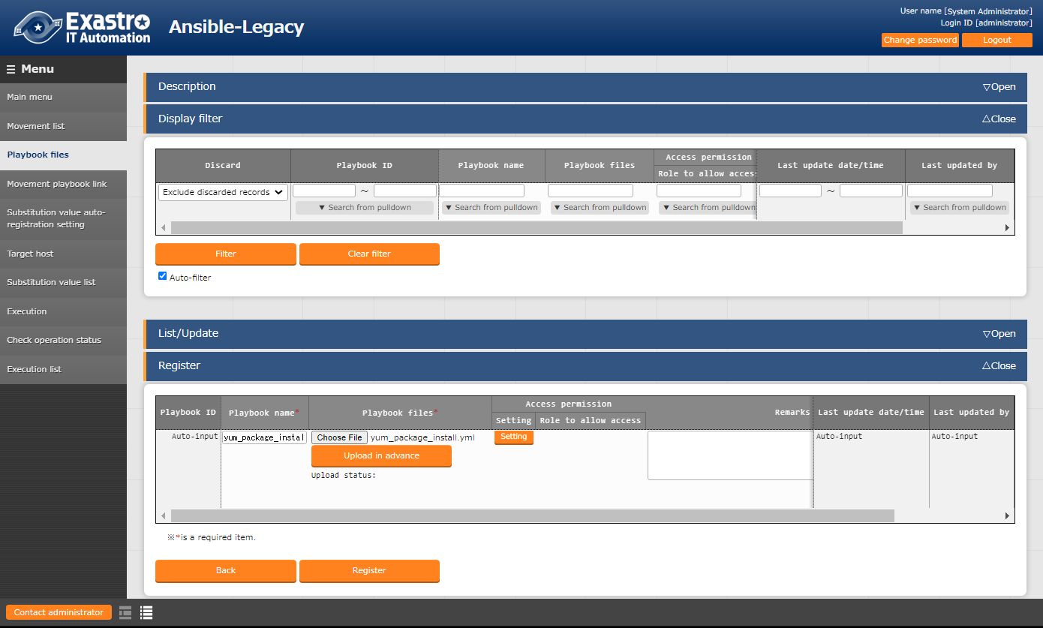
3.1 Uploading Playbook and linking it to a job(Movement) (4/5)
Register Playbook to the Playbook file menu.
Next, we will register the Playbook we created earlier to the Playbook files menu.
From the main menu , go to the Ansible-Legacy menu and then to the Playbook files menu. Fill out the items marked with red using the information from table listed below and press the “Register” button.
Uploading Playbook
and linking it to a job(Movement)
Implementing job (Movement)
into Jobflow (Conductor)
Configure CMDB Data sheet
and Parameter sheet
1
Register Data to Datasheet
2
Link Parameter sheet item
to Playbook variable.
Playbook file name | Playbook file
yum_package_install | yum_package_install.yml
Register target (Linux machine)
to Device list.
Point
If you are uploading a Playbook, make sure to hit the "Upload in advance" button before pressing the “Register” button.
3

Slide 21
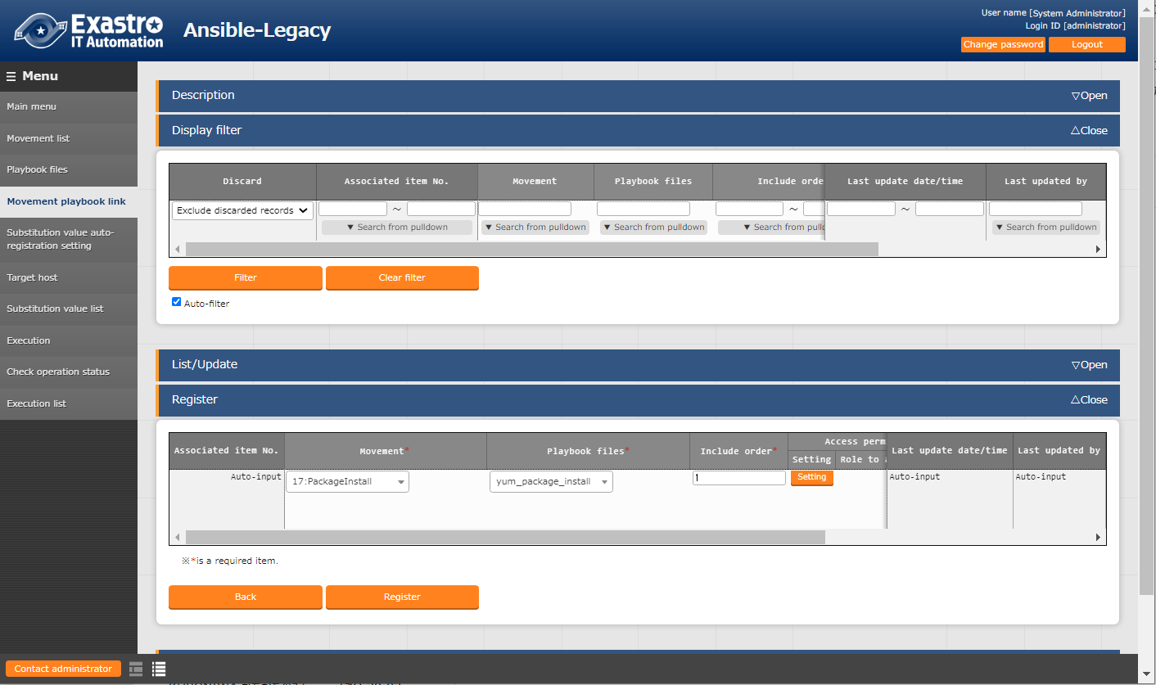
3.1 Uploading Playbook and linking it to a job(Movement) (5/5)
Register “Movement-Playbook link”
Next, we will link the playbook to the earlier registered Movement
From the main menu, go to the Ansible-Legacy menu and then to the “Movement-Playbook link” menu. Fill out the items marked with red using the information from table listed below and press the “Register” button.
Uploading Playbook
and linking it to a job(Movement)
Implementing job (Movement)
into Jobflow (Conductor)
Configure CMDB Data sheet
and Parameter sheet
1
Register Data to Datasheet
Link Parameter sheet item
to Playbook variable.
Movement | Playbook file | Include order
Install Package | yum_package_install | 1
Register target (Linux machine)
to Device list.
2
Point
If you want to registered a single movement to multiple Playbooks. For 1:1, please input 1.
3

Slide 22
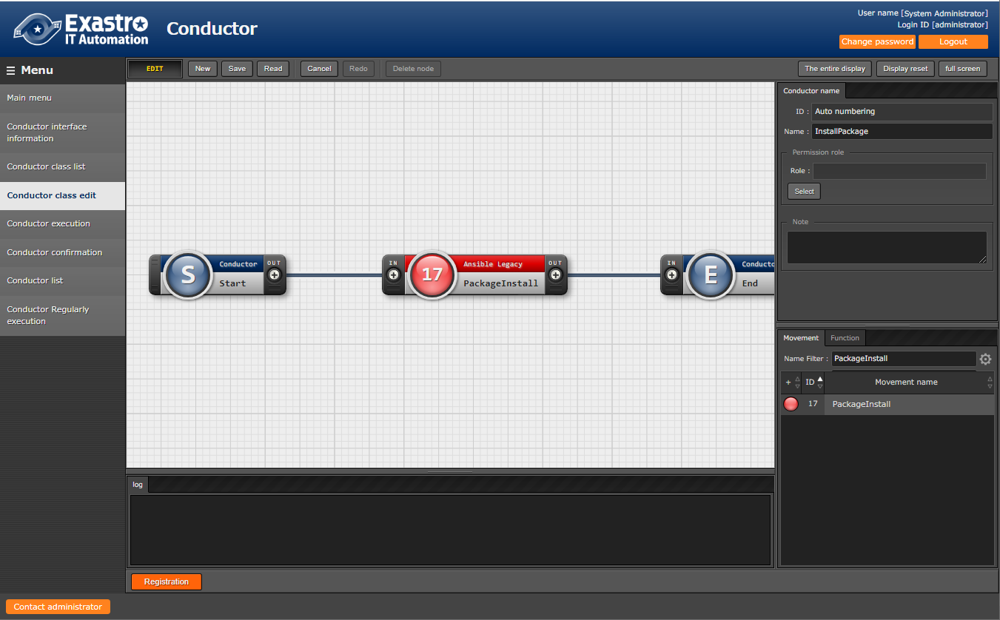
3.2 Implementing job (Movement)into Jobflow (Conductor)
Create “Conductor”
In the next step, we will implement the Movement into a conductor.
From the Conductor menu group, access the Conductor Class edit screen.
Follow the numbered steps below and press the “Register” button.
Uploading Playbook
and linking it to a job(Movement)
Name
InstallPackage
Implementing job (Movement)
into Jobflow (Conductor)
2
Configure CMDB Data sheet
and Parameter sheet
Input field for Remarks and such.
Register Data to Datasheet
１
Drag and Drop
Link Parameter sheet item
to Playbook variable.
Register target (Linux machine)
to Device list.
3
4
Drag a line between “OUT” and “IN”
5

Slide 23
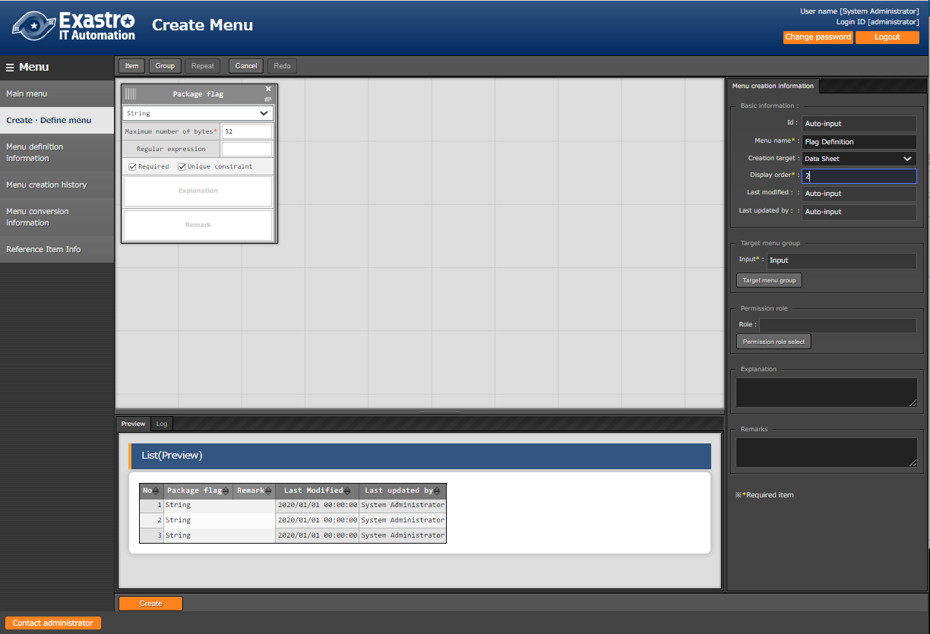
3.3 Configure CMDB Data sheet and Parameter sheet (1/4)
Create Data sheet
Next, we will create a Data sheet
From the “Menu create” menu group, access the “Create・Define menu” menu.
Fill out the items marked with red using the information from table listed below and press the “”Create”” button.
Menu name | Creation Target | Display order
Flag Definition | Data sheet | 2
Uploading Playbook
and linking it to a job(Movement)
１
2
Implementing job (Movement)
into Jobflow (Conductor)
Configure CMDB Data sheet
and Parameter sheet
Register Data to Datasheet
Link Parameter sheet item
to Playbook variable.
3
Register target (Linux machine)
to Device list.
Item name | Input method | Maximum byte size | Required | Unique constraint
Package flag | String | 32 | ✔ | ✔
4

Slide 24
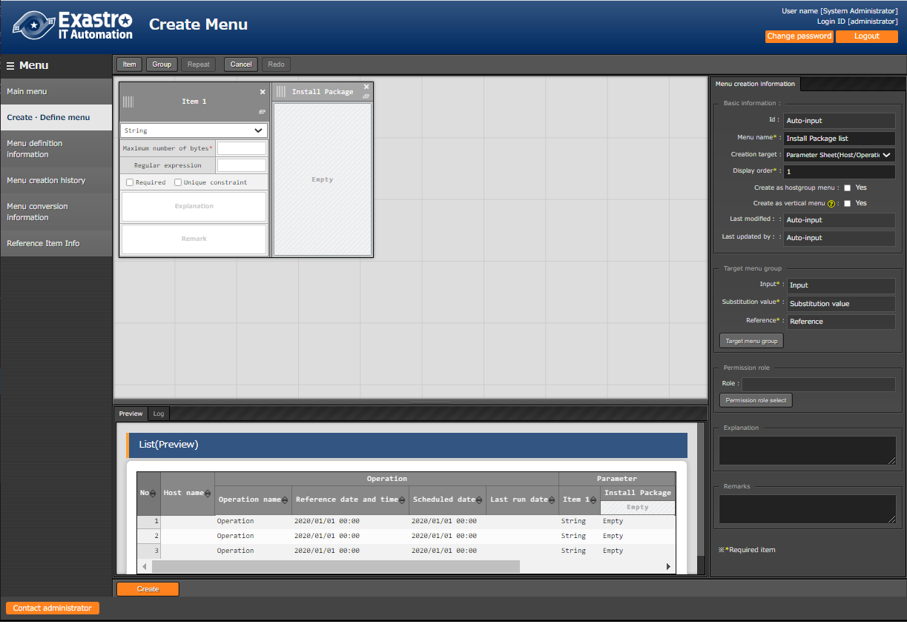
3.3 Configure CMDB Data sheet and Parameter sheet (2/4)
Create Parameter sheet
In the next step, we will create a parameter sheet.
In the "Create menu" menu group, go to the "Define/Create Menu" menu.
Follow the steps below and fill out the items with the values written in the tables.
2
Uploading Playbook
and linking it to a job(Movement)
Click “Group”
Implementing job (Movement)
into Jobflow (Conductor)
Configure CMDB Data sheet
and Parameter sheet
Register Data to Datasheet
3
Link Parameter sheet item
to Playbook variable.
Group name
Install Package
Register target (Linux machine)
to Device list.
１
Menu name | Creation target | Display Order
Install Package list | Parameter sheet (Host/ Operation) | 1

Slide 25
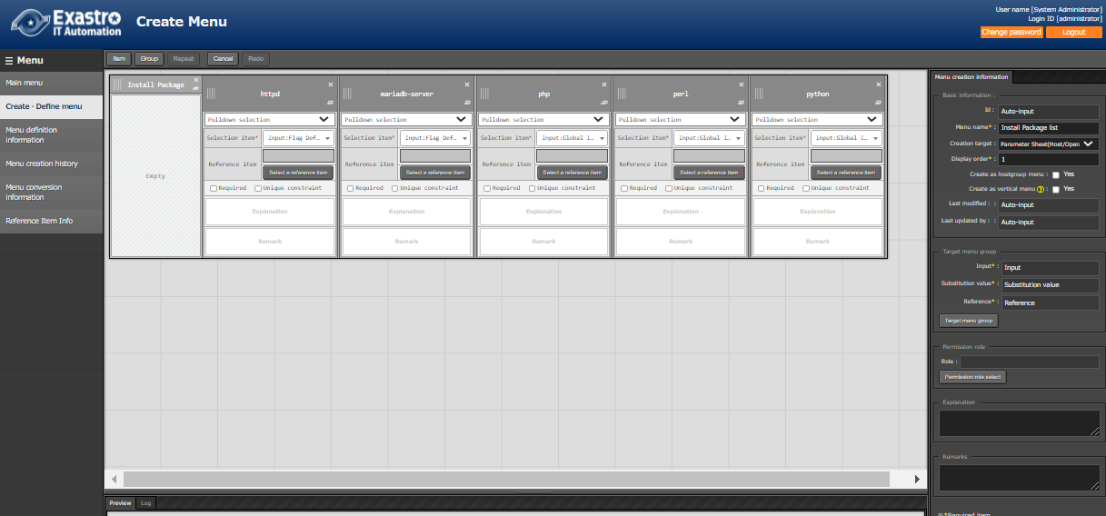
3.3 Configure CMDB Data sheet and Parameter sheet (3/4)
Create Parameter sheet
Add items and fill the items with the values written in the table below.
4
Add items so there are 5 in total
Uploading Playbook
and linking it to a job(Movement)
Implementing job (Movement)
into Jobflow (Conductor)
Configure CMDB Data sheet
and Parameter sheet
Register Data to Datasheet
5
Link Parameter sheet item
to Playbook variable.
Item name | Input method | Selection item
httpd | Pulldown Selection | Input:Flag Definition: Parameter/Package flag
mariadb-server | Pulldown Selection | Input:Flag Definition: Parameter/Package flag
php | Pulldown Selection | Input:Flag Definition: Parameter/Package flag
perl | Pulldown Selection | Input:Flag Definition: Parameter/Package flag
python | Pulldown Selection | Input:Flag Definition: Parameter/Package flag
Register target (Linux machine)
to Device list.

Slide 26
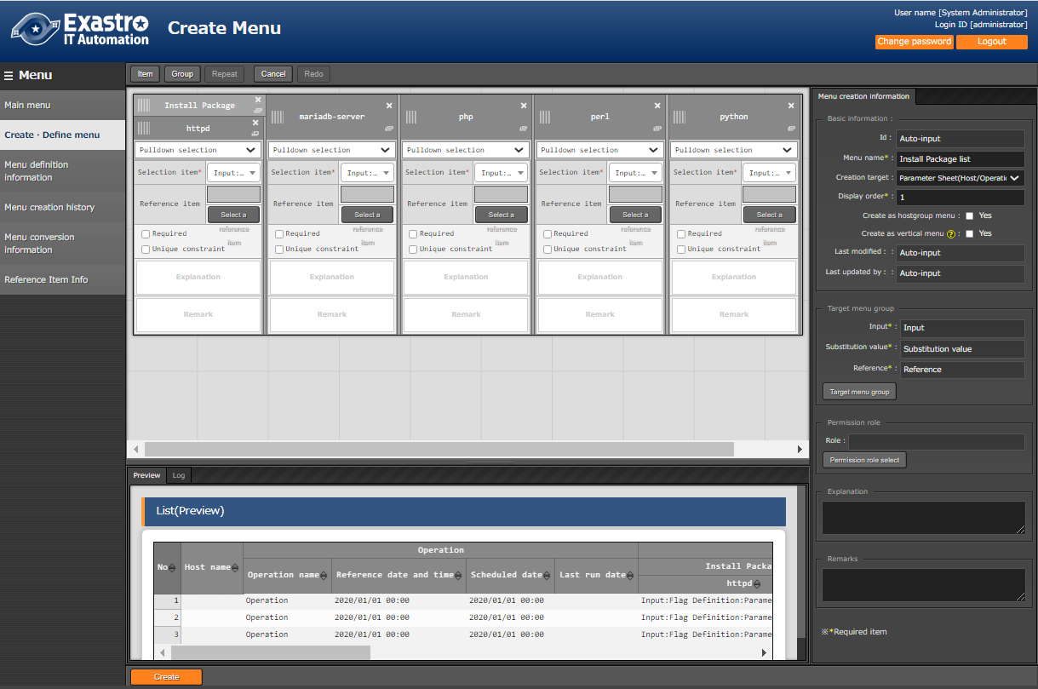
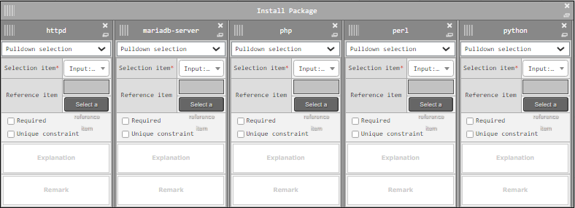
3.3 Configure CMDB Data sheet and Parameter sheet (4/4)
Create Parameter sheet
After following the steps below, click the “Create” button.
6
Drag and drop the items into the column group
Uploading Playbook
and linking it to a job(Movement)
Implementing job (Movement)
into Jobflow (Conductor)
Configure CMDB Data sheet
and Parameter sheet
Register Data to Datasheet
7
Link Parameter sheet item
to Playbook variable.
When finished, the items should look like this
Register target (Linux machine)
to Device list.
8

Slide 27
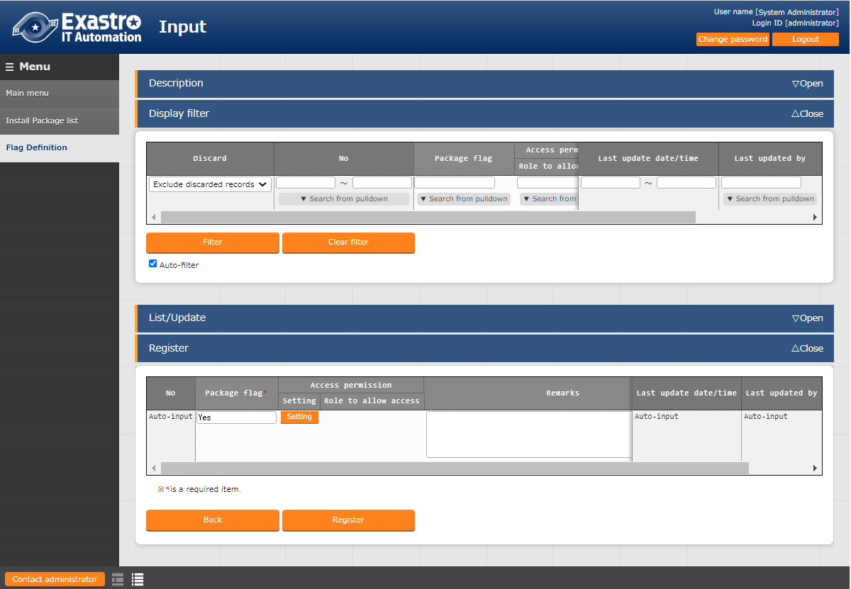
3.4 Register Data to Datasheet
Register data to “Flag definition”
We are now going to register data in the Flag Definition (Datasheet) that we created earlier.
Go to the "Input" menu group and then to the "Flag Definition" Menu.
Then in the Register submenu, fill the items with the values below and press "Register".
Uploading Playbook
and linking it to a job(Movement)
Implementing job (Movement)
into Jobflow (Conductor)
1
Configure CMDB Data sheet
and Parameter sheet
2
Register Data to Datasheet
Package Flag
Yes
Link Parameter sheet item
to Playbook variable.
Register target (Linux machine)
to Device list.
3

Slide 28
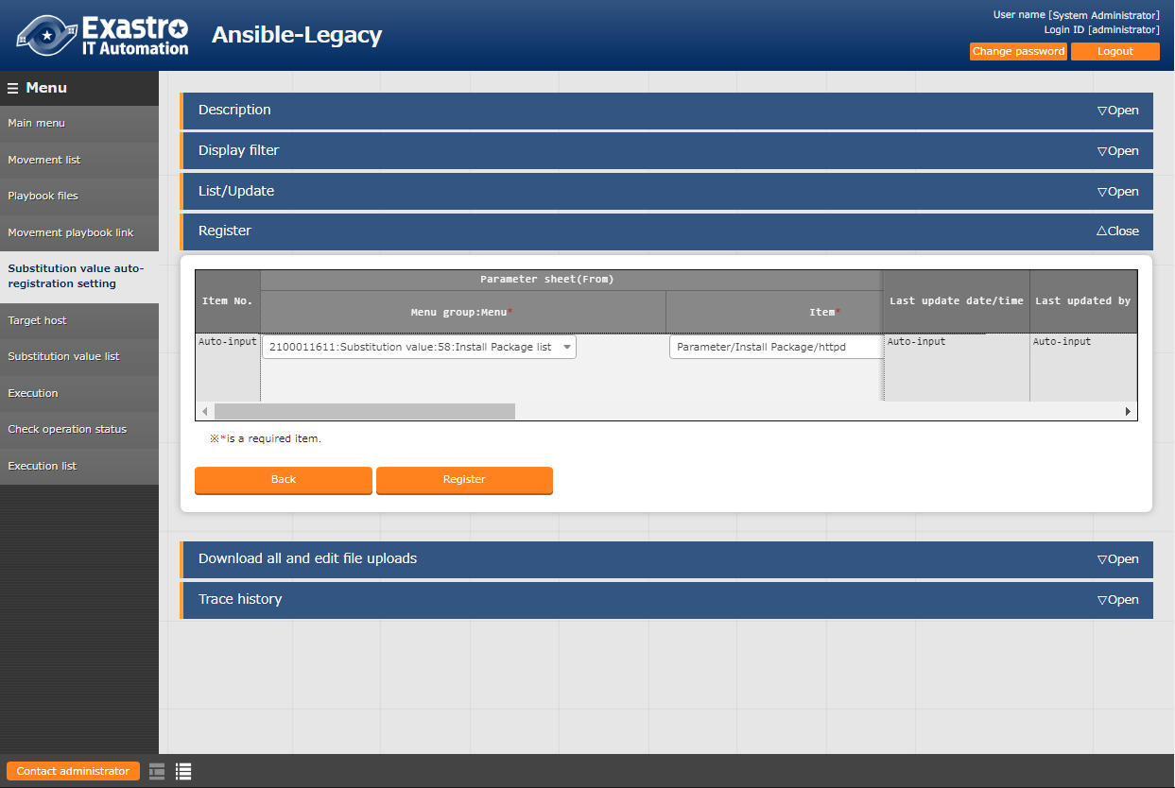
3.5 Link Parameter sheet item to Playbook variable (1/3)
Create "Substitution value auto-registration settings".
Lastly, we will automatically register substitute values. In the "Ansible-Legacy" Menu group, go to the "Substitution value auto-registration setting" menu. Follow the steps below and fill the items with the values written in the table below.
Uploading Playbook
and linking it to a job(Movement)
Implementing job (Movement)
into Jobflow (Conductor)
１
Configure CMDB Data sheet
and Parameter sheet
Register Data to Datasheet
Link Parameter sheet item
to Playbook variable.
2
Menu group:Menu | Item | Registration method | Movement | Key Variable Variable name | Substitution order
2100011611:Susbtitution value:3:Install Package list | Parameter/Install Package/httpd | Key type | 1:PackageInstall | 1:VAR_packages | 1
2100011611:Susbtitution value:3:Install Package list | Parameter/Install Package/mariadb-server | Key type | 1:PackageInstall | 1:VAR_packages | 2
2100011611:Susbtitution value:3:Install Package list | Parameter/Install Package/php | Key type | 1:PackageInstall | 1:VAR_packages | 3
2100011611:Susbtitution value:3:Install Package list | Parameter/Install Package/perl | Key type | 1:PackageInstall | 1:VAR_packages | 4
2100011611:Susbtitution value:3:Install Package list | Parameter/Install Package/python | Key type | 1:PackageInstall | 1:VAR_packages | 5
Register target (Linux machine)
to Device list.

Slide 29
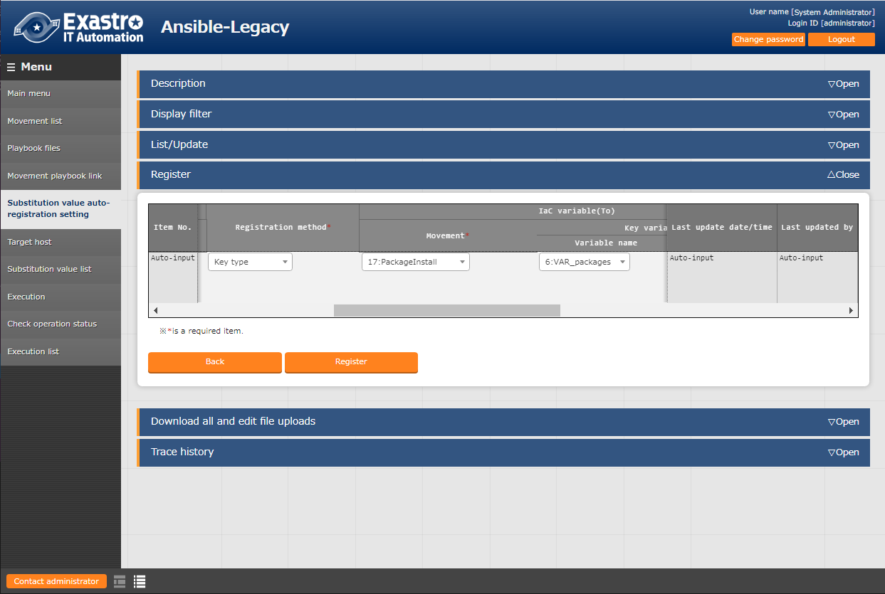
3.5 Link Parameter sheet item to Playbook variable (2/3)
Create "Substitution value auto-registration settings".
Follow the table below and press the "Register" button.
Uploading Playbook
and linking it to a job(Movement)
Implementing job (Movement)
into Jobflow (Conductor)
Configure CMDB Data sheet
and Parameter sheet
Register Data to Datasheet
Link Parameter sheet item
to Playbook variable.
2
Register target (Linux machine)
to Device list.
Point
The following table describes the 3 different variable link registration methods.
Registration method | Use | Description
Value type |  | Basic registration type. Links the value written in the table to the variable.
Key type | ● | Links the table item (column name) to the variable. If the item's setting value is blank, it will not be linked.
Key-Value type |  | Links both the item name (Key) and the setting value (Value) to the variable.
In this scenario, we want to assign the table items (column name) to the Playbook as a specific value, so we will choose the "Key" registration method.
For more information, please see the Exastro_System_Operation_and_Construction_Efficiency_Guide

Slide 30
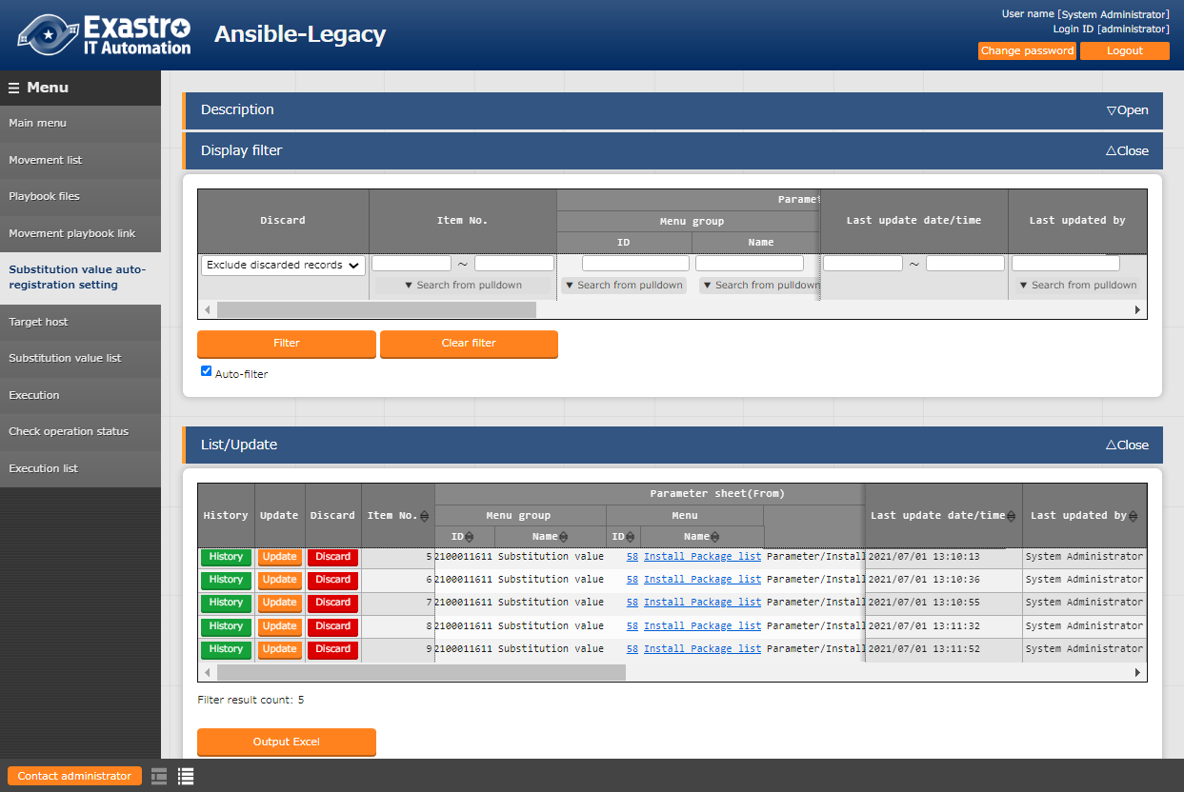
3.5 Link Parameter sheet item to Playbook variable (3/3)
Create "Substitution value auto-registration settings".
Use the Display filter to check that you have registered 5 items.
This will end the preparation operations.
Uploading Playbook
and linking it to a job(Movement)
3
Implementing job (Movement)
into Jobflow (Conductor)
Configure CMDB Data sheet
and Parameter sheet
Register Data to Datasheet
4
Link Parameter sheet item
to Playbook variable.
5
Check that 5 items are registered
Register target (Linux machine)
to Device list.

Slide 31
4. Execution (First time)

Slide 32
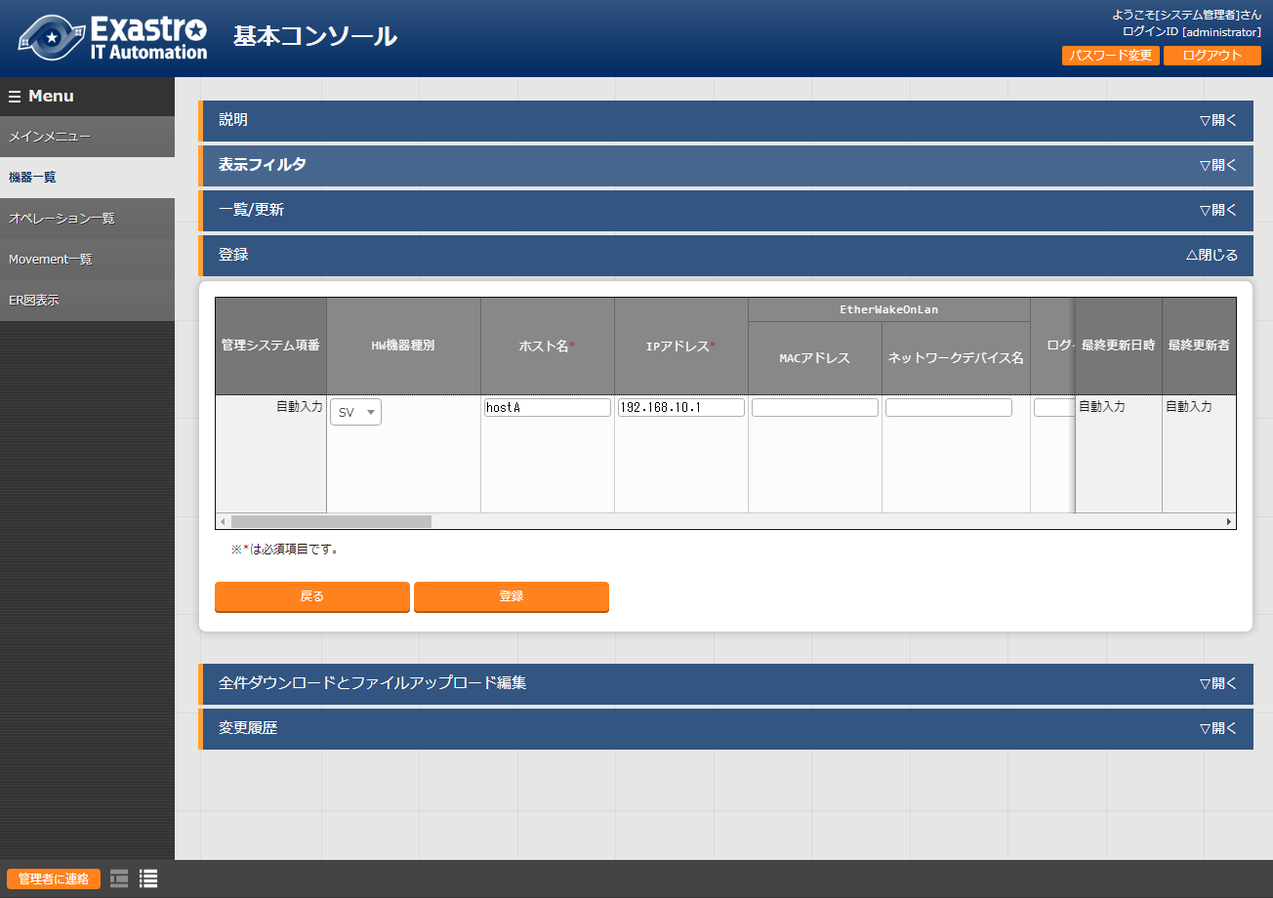
4.1 Register target (Linux machine) to Device list (1/3)
Register target host to "Device list".
First, we will have to register the target host to which we will install packages to.
From the "Basic Console" Menu group, go to the "Device list" menu. Fill in the information written in the table below.
Uploading Playbook
and linking it to a job(Movement)
Implementing job (Movement)
into Jobflow (Conductor)
１
Configure CMDB Data sheet
and Parameter sheet
Register Data to Datasheet
Link Parameter sheet item
to Playbook variable.
Register target (Linux machine)
to Device list.
2
HW Device type | Host name | IP Address
SV | (Free host name) | (Free IP Address)

Slide 33
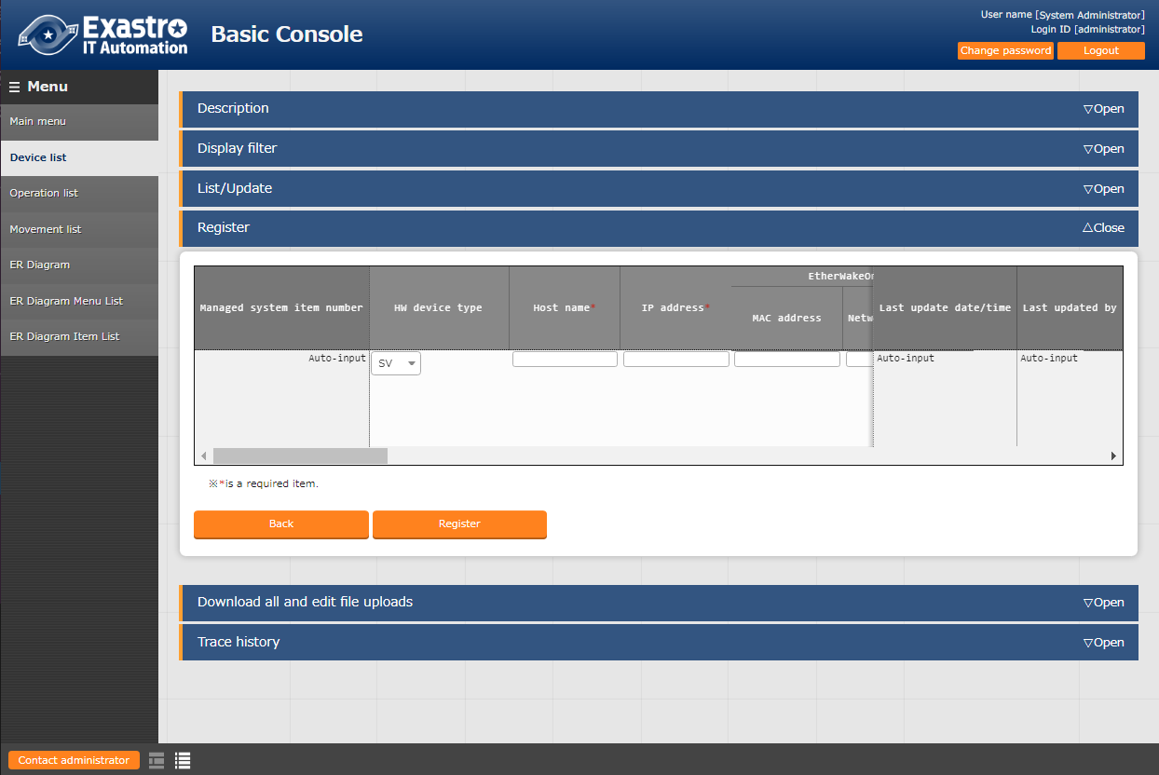
4.1 Register target (Linux machine) to Device list (2/3)
Register target host to "Device list".
Use the scrollbar to scroll to the left and fill in the items listed below.
Uploading Playbook
and linking it to a job(Movement)
Implementing job (Movement)
into Jobflow (Conductor)
Configure CMDB Data sheet
and Parameter sheet
Register Data to Datasheet
Link Parameter sheet item
to Playbook variable.
2
Register target (Linux machine)
to Device list.
Login user ID | Login password management | Login Password
(Login user ID) | ● | (Login password)

Slide 34
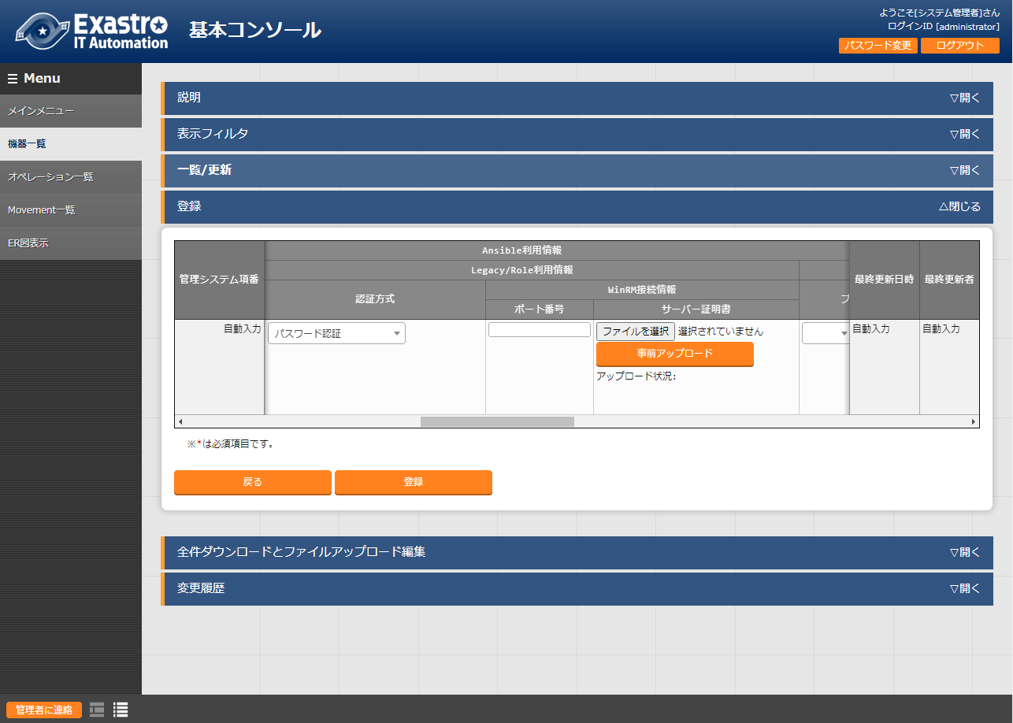
4.1 Register target (Linux machine) to Device list (3/3)
Register target host to "Device list".
Use the table below to fill in the last item and press the "Register" button.
3
Uploading Playbook
and linking it to a job(Movement)
Dedicated information for Legacy/Role Authentication method
Password authentication
Implementing job (Movement)
into Jobflow (Conductor)
Configure CMDB Data sheet
and Parameter sheet
Register Data to Datasheet
Link Parameter sheet item
to Playbook variable.
Register target (Linux machine)
to Device list.
4
Point
In order to run Ansible-Legacy, the following 6 items must be filled.
"Host name", "IP Address", "Login User ID", "Login Password Management", "Login password", "Authentication method※"
※In this document, "Authentication method" is written as "Password authentication".

Slide 35
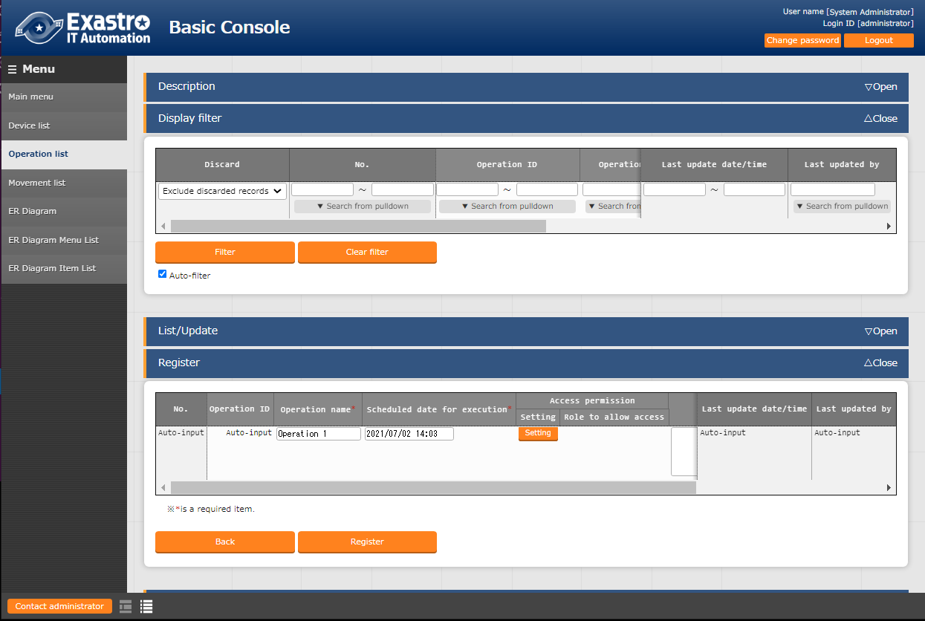
4.2 Register Operation name (Operation)
Register "Operation name" to "Operation list"
In this step, we will register an Operation name. From the "Basic Console" menu group, go to the "Operation list" menu.
Input the following information and press the "Register" button.
Register Operation name (Operation)
Register data to Parameter sheet
1
Execute Jobflow (Conductor)
Check Execution results
2
Operation name | Scheduled date and time
Operation 1 | (Free date/time)
3

Slide 36
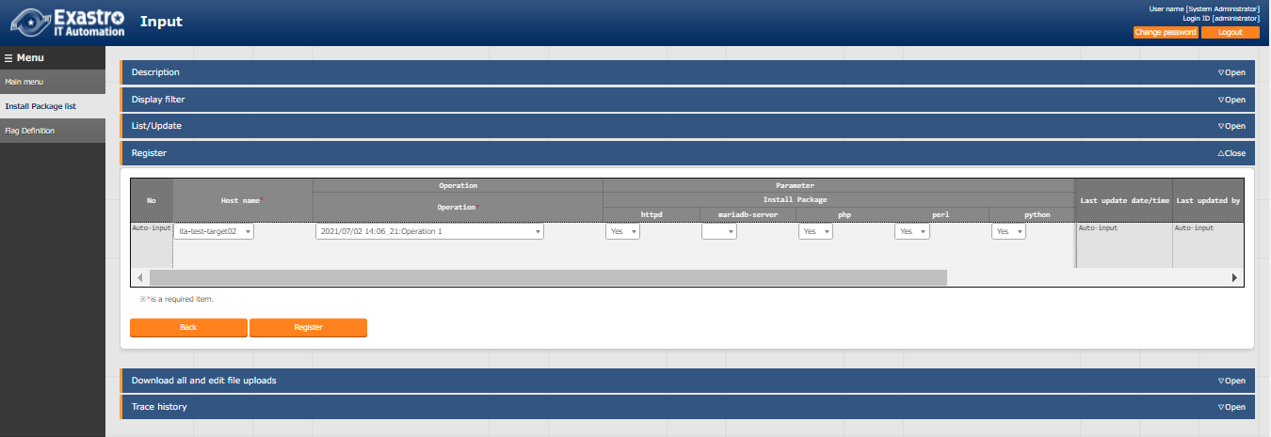
4.3 Register data to Parameter sheet (1/2)
Register data to Install Package list.
In the next step, we are going to input data to the Install package list (Parameter sheet) that we prepared earlier.
Go to the "Input" menu and then the "Install package list" menu.
Input the following information and press the "Register" button.
Register Operation name (Operation)
Register data to Parameter sheet
1
Execute Jobflow (Conductor)
Check Execution results
3
2
Host name | Operation | httpd | mariadb-server | php | perl | python
(Previously registered host) | (previously specified date )_1:Operation 1 | Yes |  | Yes | Yes | Yes

Slide 37
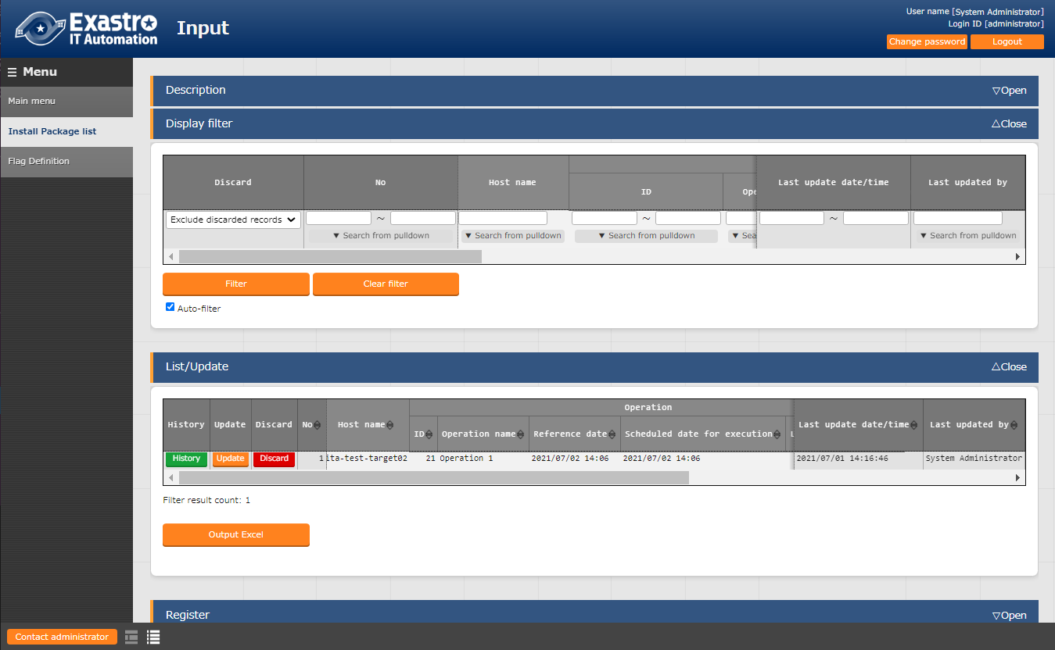
4.3 Register data to Parameter sheet (2/2)
Register data to Install Package list.
Similarly to when we configured substitution value settings, open the display filter and press the "filter" button to check if the registration was done correctly.
Register Operation name (Operation)
1
Register data to Parameter sheet
Execute Jobflow (Conductor)
２
Check Execution results
3

Slide 38
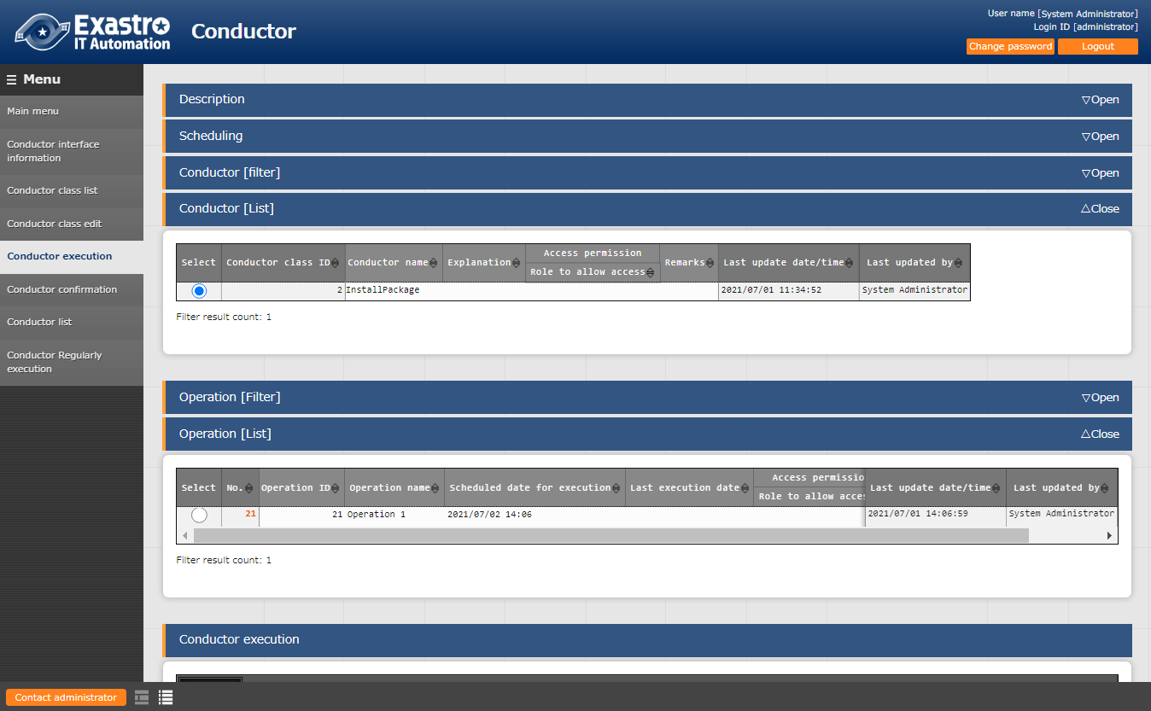
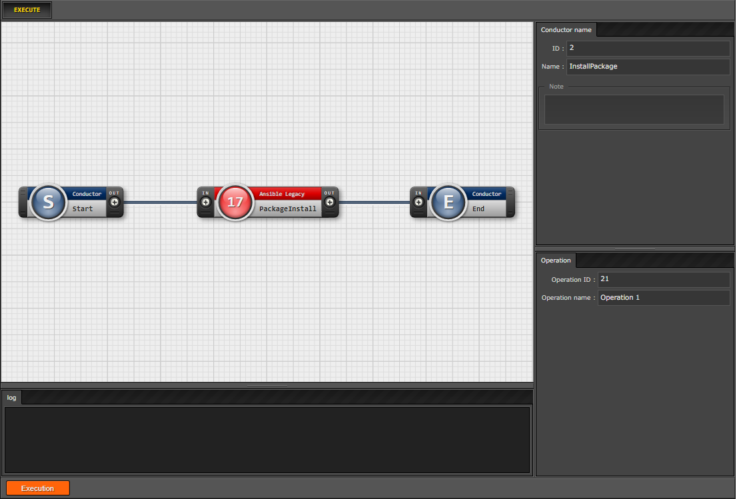
4.4 Execute Jobflow (Conductor) (1/3)
Run Conductor
We will now start the Conductor.
From the "Conductor" Menu group, go to the "Conductor Execution" Menu.
Next, select "Conductor" and "Operation" and press "Execute.
Register Operation name (Operation)
Register data to Parameter sheet
2
Execute Jobflow (Conductor)
１
Check Execution results
3
4

Slide 39
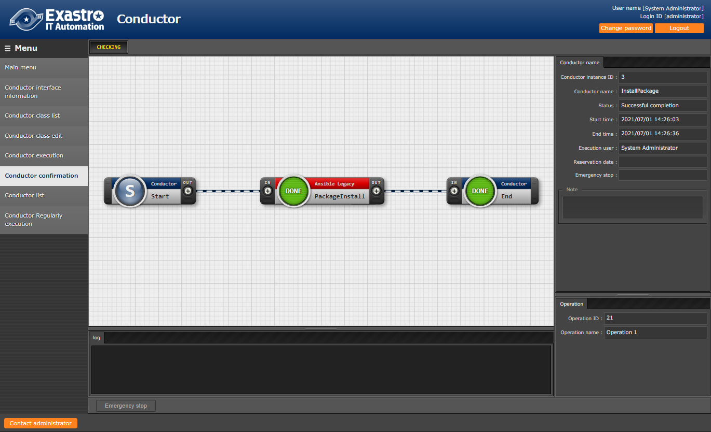
4.4 Execute Jobflow (Conductor) (2/3)
Execution results
Executing the Conductor will move the user to the "Conductor confirmation" screen where execution status and execution logs are displayed.
Register Operation name (Operation)
Register data to Parameter sheet
Execute Jobflow (Conductor)
Check Execution results
Point
The execution status and execution log can be checked in real-time.

Slide 40

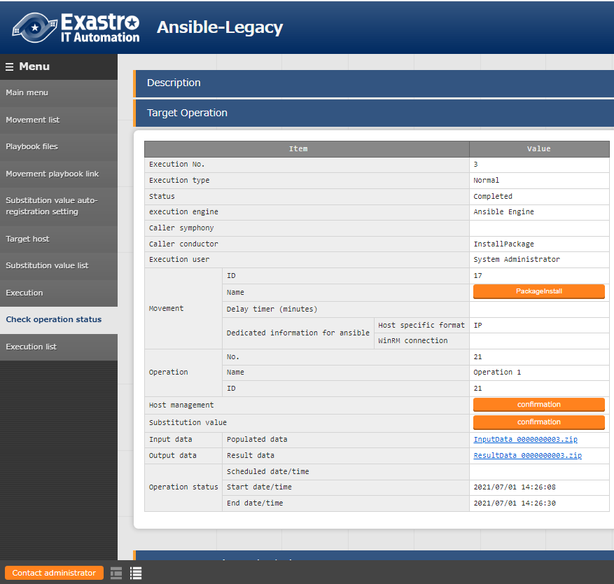
4.4 Execute Jobflow (Conductor) (3/3)
Execution results
Select a job (Movement) and press either the "Done" icon or the Operation status on the right to see more details.
Register Operation name (Operation)
１
Register data to Parameter sheet
Select
Execute Jobflow (Conductor)
Check Execution results

Slide 41
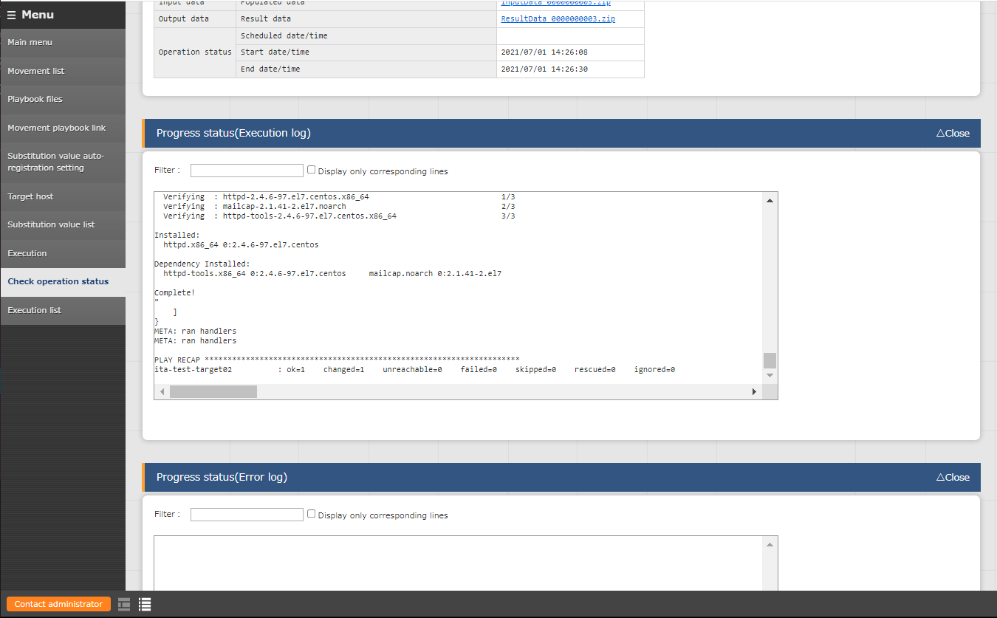
4.5 Check Execution results (1/3)
Execution results
In the detailed results screen, we can use the progress status (Execution log) to check the Ansible execution log.
Register Operation name (Operation)
Register data to Parameter sheet
Execute Jobflow (Conductor)
Check Execution results

Slide 42
4.5 Check Execution results (2/3)
Execution results
Use the Execution log to see if httpd, php, perl and python are installed.
Progress log(Execution log)
Installed:
httpd.x86_64 0:2.4.6-97.el7.centos php.x86_64 0:5.4.16-48.el7
Dependency Installed:
httpd-tools.x86_64 0:2.4.6-97.el7.centos libzip.x86_64 0:0.10.1-8.el7
mailcap.noarch 0:2.1.41-2.el7 php-cli.x86_64 0:5.4.16-48.el7
php-common.x86_64 0:5.4.16-48.el7
Updated:
perl.x86_64 4:5.16.3-299.el7_9 python.x86_64 0:2.7.5-90.el7
Dependency Updated:
perl-libs.x86_64 4:5.16.3-299.el7_9 python-libs.x86_64 0:2.7.5-90.el7
Complete!
"
]
}
Register Operation name (Operation)
Register data to Parameter sheet
Execute Jobflow (Conductor)
Check Execution results

Slide 43
4.5 Check Execution results (3/3)
Check the Target machine.
Check that the packages are installed on the Target machine.
hostA
$ yum list installed httpd
Loaded plugins: fastestmirror, langpacks
Loading mirror speeds from cached hostfile
* base: ftp-srv2.kddilabs.jp
* extras: ftp-srv2.kddilabs.jp
* updates: ftp-srv2.kddilabs.jp
Installed Packages
httpd.x86_64 2.4.6-97.el7.centos @updates
Register Operation name (Operation)
Register data to Parameter sheet
Execute Jobflow (Conductor)
Check Execution results

Slide 44
5. Execution (Second time)

Slide 45
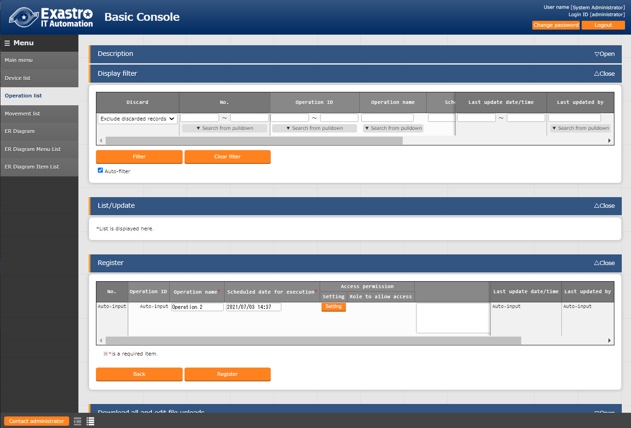
5.1 Register Operation name (Operation)
Register Operation name to the "Operation list".
This step will be the same as the first time we registered an operation name.
From the "Basic Console" menu group, go to the "Operation list" menu.
Input the information below and press the "Register" button.
Register Operation name (Operation)
Register data to Parameter sheet
1
Execute Jobflow (Conductor)
Check Execution results
2
Operation name | Reservation date/time
Operation 2 | (Free date/time)
3

Slide 46
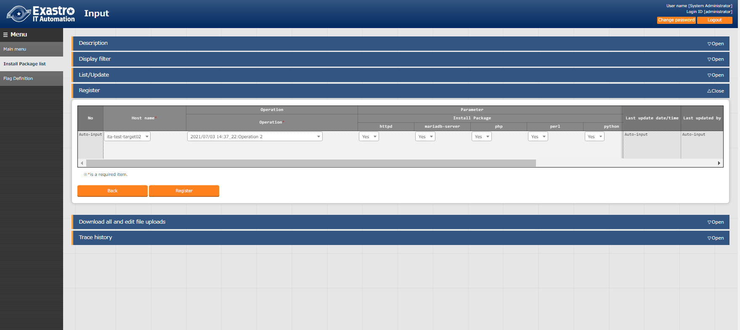
5.2 Register data to Parameter sheet
Register data to “Install Package list”
From the "Input" menu group, go to the "Install package list" menu
Input the information below and press the "Register" button. Please note that the packages we are installing are different from the first time.
Register Operation name (Operation)
1
Register data to Parameter sheet
Execute Jobflow (Conductor)
Check Execution results
3
2
Host name | Operation | httpd | mariadb-server | php | perl | python
(Previously registered host) | (Previously specified date )_1:Operation 1 | Yes | Yes | Yes | Yes | Yes

Slide 47
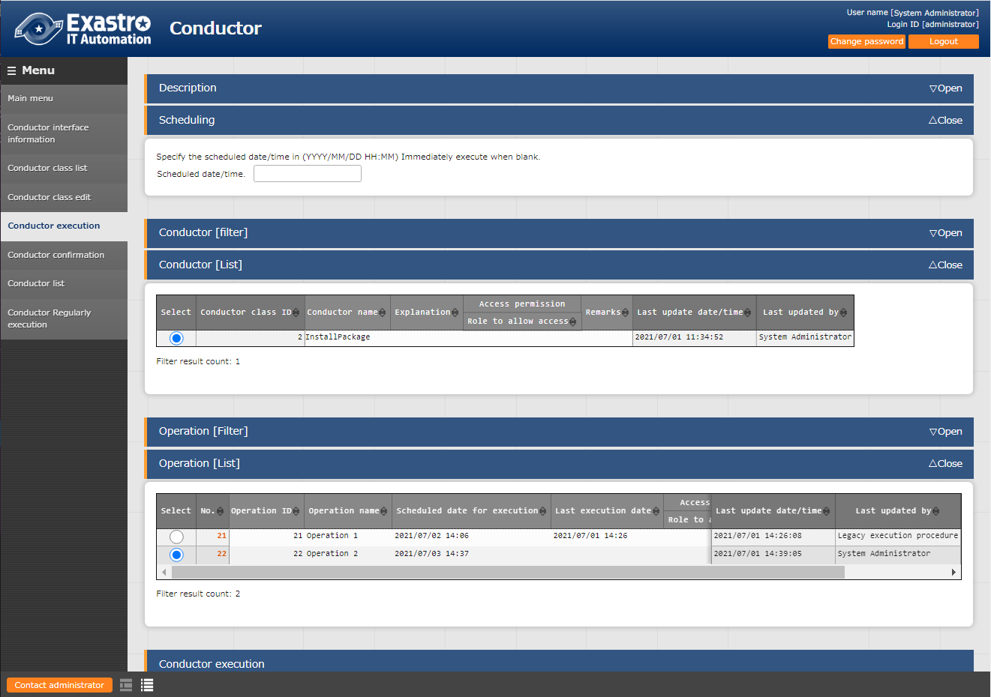
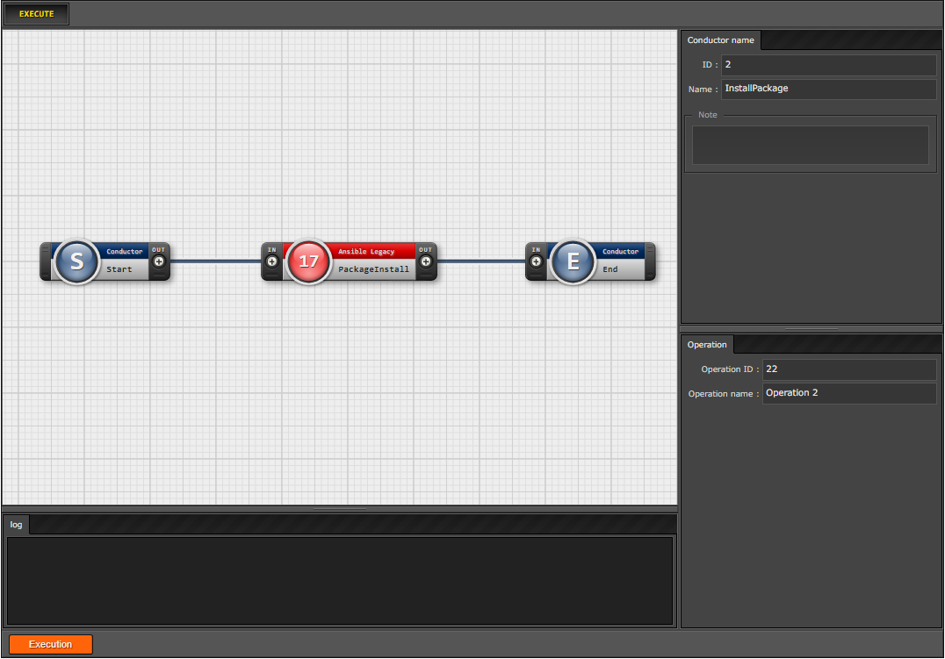
5.3 Execute Jobflow (Conductor) (1/3)
Run Conductor
We will now run the Conductor a second time.
From the “Conductor” Menu group, go to the “Conductor execution” menu.
Select the Conductor and Operation you want to run and press “Execute”.
Register Operation name (Operation)
Register data to Parameter sheet
Execute Jobflow (Conductor)
１
2
Check Execution results
3
4

Slide 48
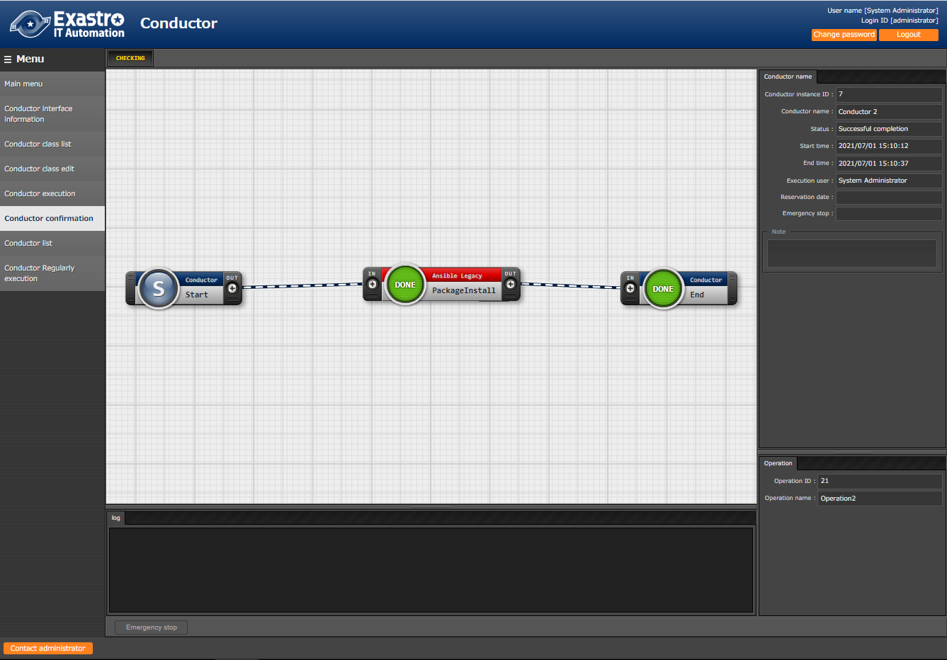
5.3 Execute Jobflow (Conductor) (2/3)
Execution results
Executing the Conductor will move the user to the "Conductor confirmation" screen where execution status and execution logs are displayed.
Register Operation name (Operation)
Register data to Parameter sheet
Execute Jobflow (Conductor)
Check Execution results
Point
The Execution status and the Execution log can be checked in real-time.

Slide 49
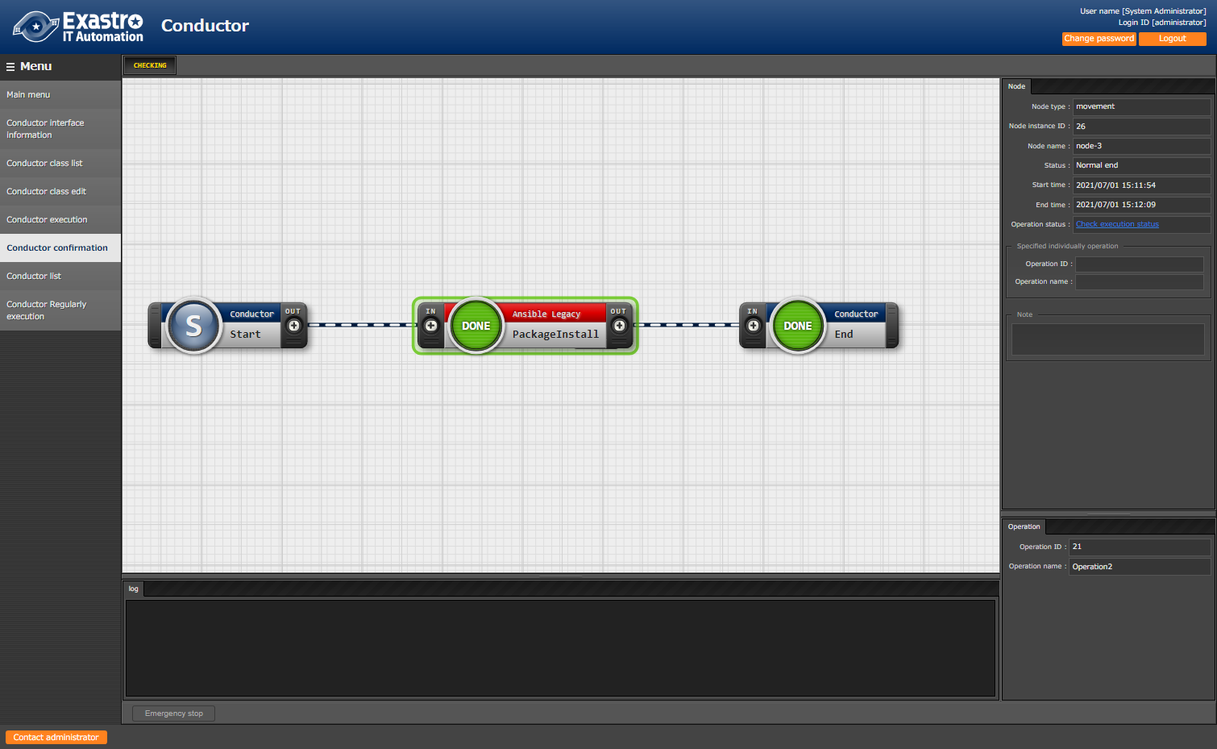
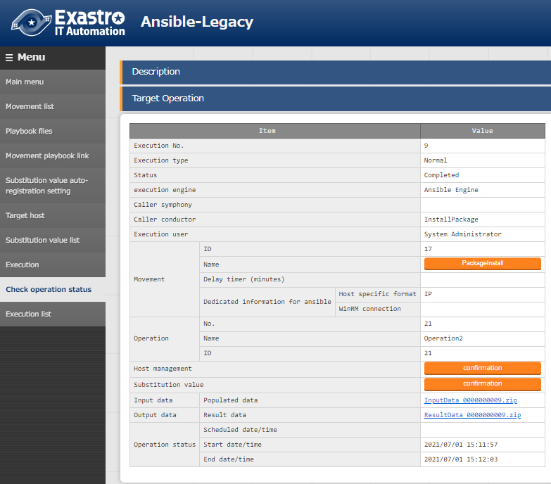
5.3 Execute Jobflow (Conductor) (3/3)
Execution results
Select a job (Movement) and press either the "Done" icon or the Operation status on the right to see more details.
Register Operation name (Operation)
Register data to Parameter sheet
１
Select
Execute Jobflow (Conductor)
Check Execution results

Slide 50
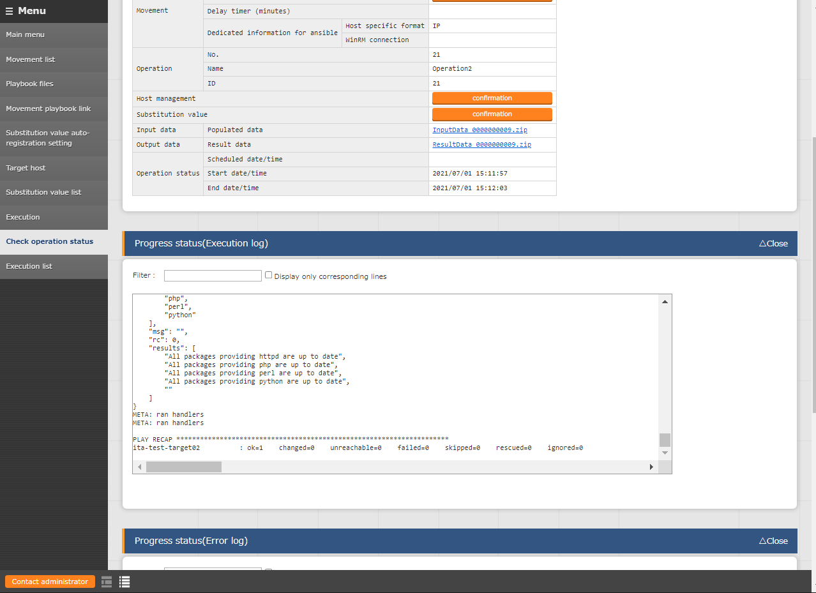
5.4 Check Execution results (1/2)
Execution results
In the detailed results screen, we can use the progress status (Execution log) to check the Ansible execution log.
Register Operation name (Operation)
Register data to Parameter sheet
Execute Jobflow (Conductor)
Check Execution results

Slide 51
5.4 Check Execution results (2/2)
Execution results
Check that the new installed Maria DB's dependency with other packages are correct and that the other 4 packages (htpd,php,perl,python) has been updated.
Progress log (Execution log)
Package httpd-2.4.6-97.el7.centos.x86_64 already installed and latest version\
Package php-5.4.16-48.el7.x86_64 already installed and latest version\
Package 4:perl-5.16.3-299.el7_9.x86_64 already installed and latest version\
Package python-2.7.5-90.el7.x86_64 already installed and latest version\
～～～～～～～～～～～～～～～～～～～～Abbreviation～～～～～～～～～～～～～～～～～～～～～～～
Installed:
mariadb-server.x86_64 1:5.5.68-1.el7
Dependency Installed:
mariadb.x86_64 1:5.5.68-1.el7
perl-Compress-Raw-Bzip2.x86_64 0:2.061-3.el7
perl-Compress-Raw-Zlib.x86_64 1:2.061-4.el7
perl-DBD-MySQL.x86_64 0:4.023-6.el7
perl-DBI.x86_64 0:1.627-4.el7
perl-IO-Compress.noarch 0:2.061-2.el7
perl-Net-Daemon.noarch 0:0.48-5.el7
perl-PlRPC.noarch 0:0.2020-14.el7
Dependency Updated:
mariadb-libs.x86_64 1:5.5.68-1.el7
Complete!
"
]
}
Register Operation name (Operation)
Register data to Parameter sheet
Execute Jobflow (Conductor)
Check Execution results

Slide 52
6. Checking the CMDB Parameter history

Slide 53
6.1 Executing operations and History Management
Scenario and History Management
ITA Manages parameter history and keeps track on who last used it, when it happened and why in the CMDB.
ITA also comes with functions that are able to extract the parameters of the system at said time. By historically managing parameters, designers and operators both can perform system maintenance without any worries or problems
Searching with a date before the first execution.
→Nothing is displayed
Searching with a date between the first and second execution.
→The first execution record is displayed
Searching with a date after the second execution.
→The second execution record is displayed
1st Execution
2nd Execution
Reference date
Point
In order for the user to experience history management of Parameters, this scenario contained 2 executions.

Slide 54
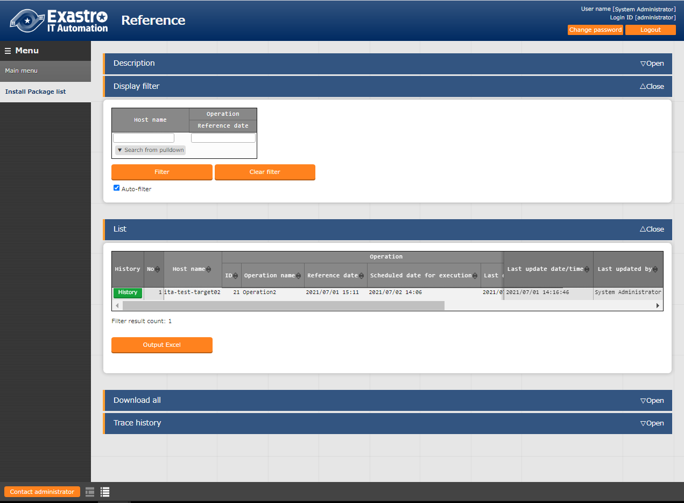
6.2 Checking the CMDB Parameter history (1/3)
History Check
Check if the parameters are actually managed.
From the "Reference" menu group, go to the "Install package list" menu.
First, press the "Filter" button without inputting any filters.
１
2
Press the “Filter” button without inputting anything
3
4
Check that the newest data is displayed correctly.

Slide 55
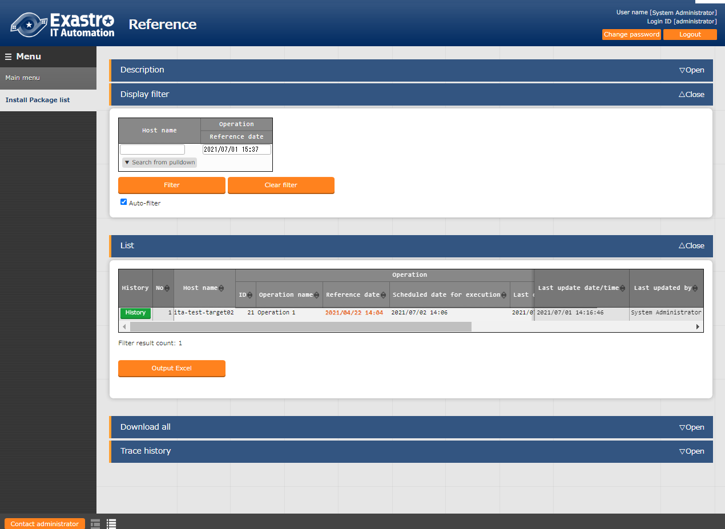
6.2 Checking the CMDB Parameter history (2/3)
History Check
Now, we will input a reference date that took place earlier than the second execution and filter.
１
Input a date earlier than the second execution date.
2
3
Check that only the first execution is displayed.

Slide 56
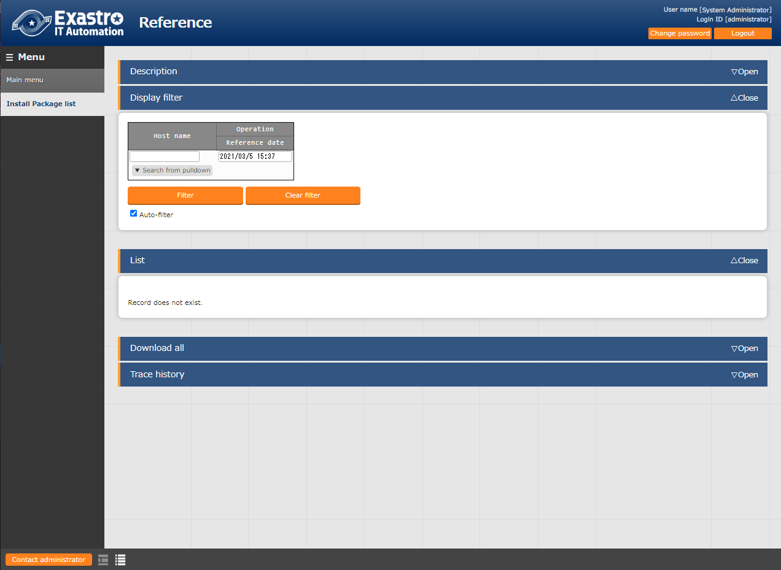
6.2 Checking the CMDB Parameter history (3/3)
History Check
Lastly, input a date earlier than the first execution.
１
Input a date earlier than the first execution
2
3
Check that nothing is displayed

Slide 57
A Appendix

Slide 58
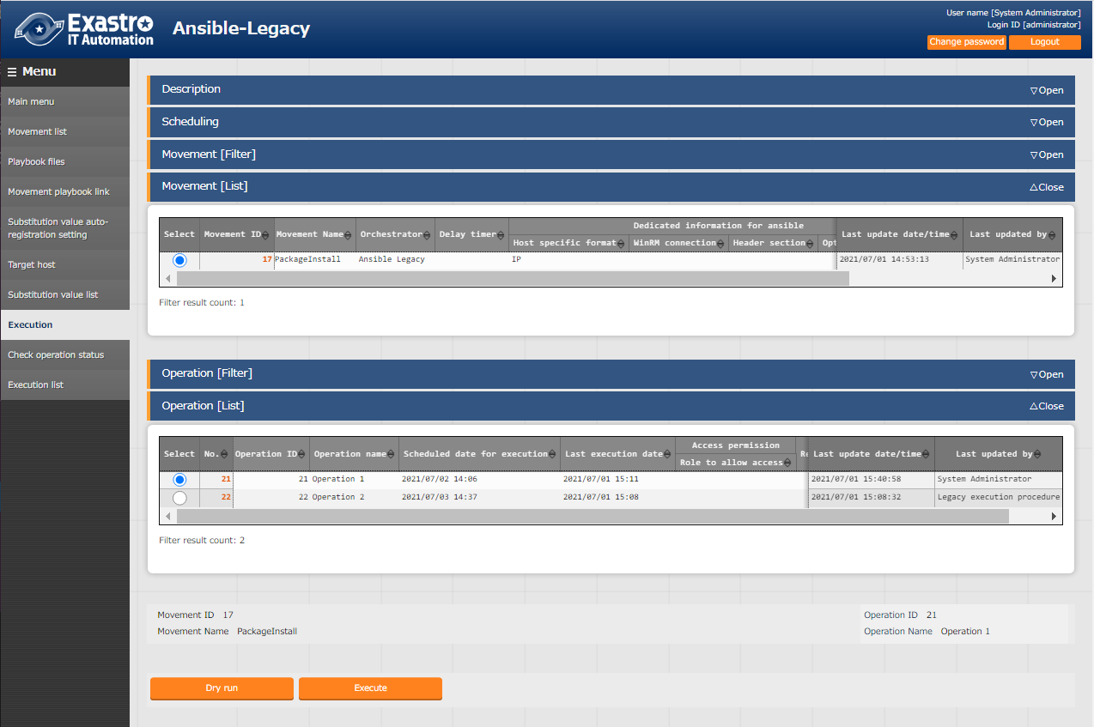
Reference ① 【Ansible-Legacy】Single Execution
Execution menu
Ansible-Legacy has a "Execution" menu where users can execute individual movements and dry run them.
１
Select a created Movement
２
Select an operation linked to the Movement
３
Dry run
 | ：Checks the playbook’s connectivity and syntax
Execute
 | ：Executes playbook.

Slide 59
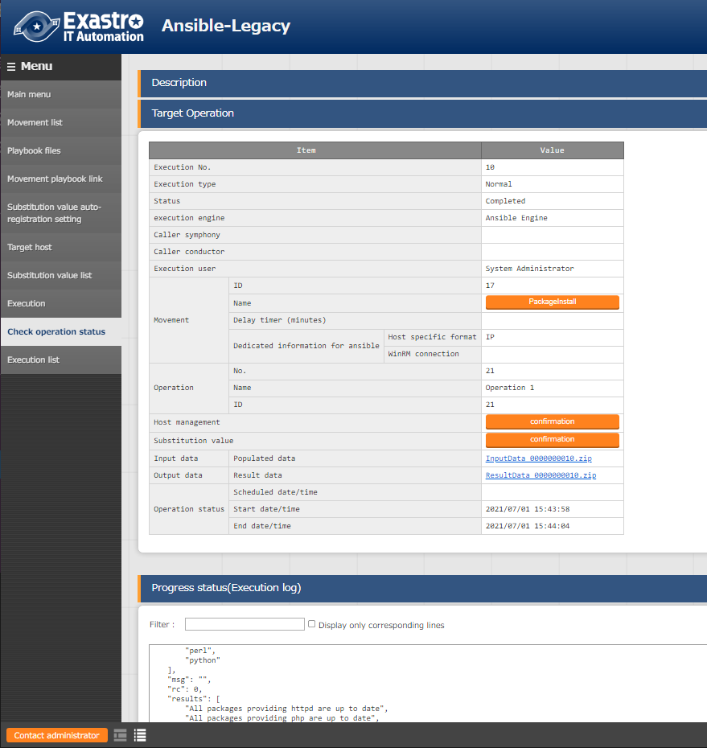
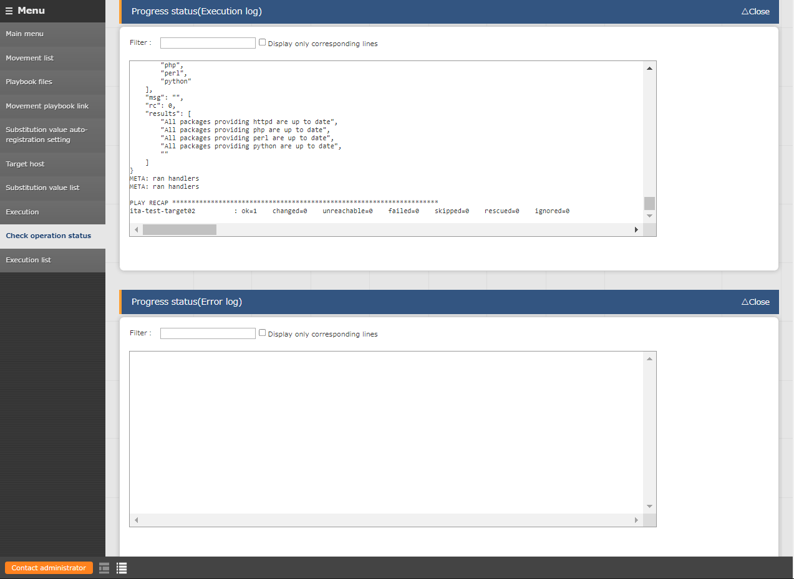
Reference ② 【Ansible-Legacy】Execution check
Execution result
Pressing either the Execute or the Dry run button will move the user to a screen where execution status and logs are displayed.
Here you can see the input data and the execution status.
Point
Point
Here you can see both the execution log and the error log in real time.
Point
Here you can download both the input data and the result data.

